Slide 1
PyTorch Tutorial
Naeemullah Khan

Slide 2
Topics
PyTorch Basics
Simple NN in PyTorch
Vectorization
Convolutional Neural Networks
DataLoaders
Data Augmentation
Transfer Learning

Slide 3
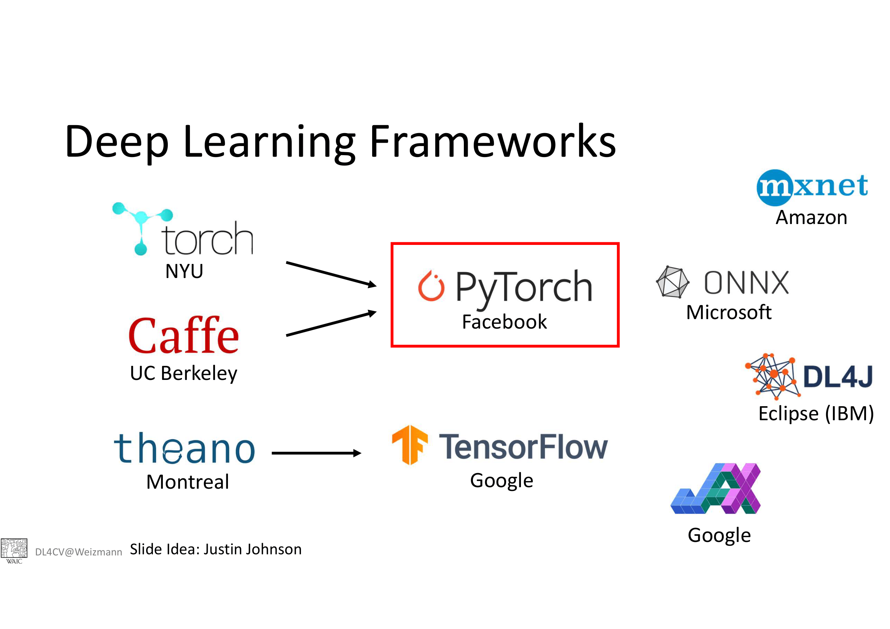

Slide 4
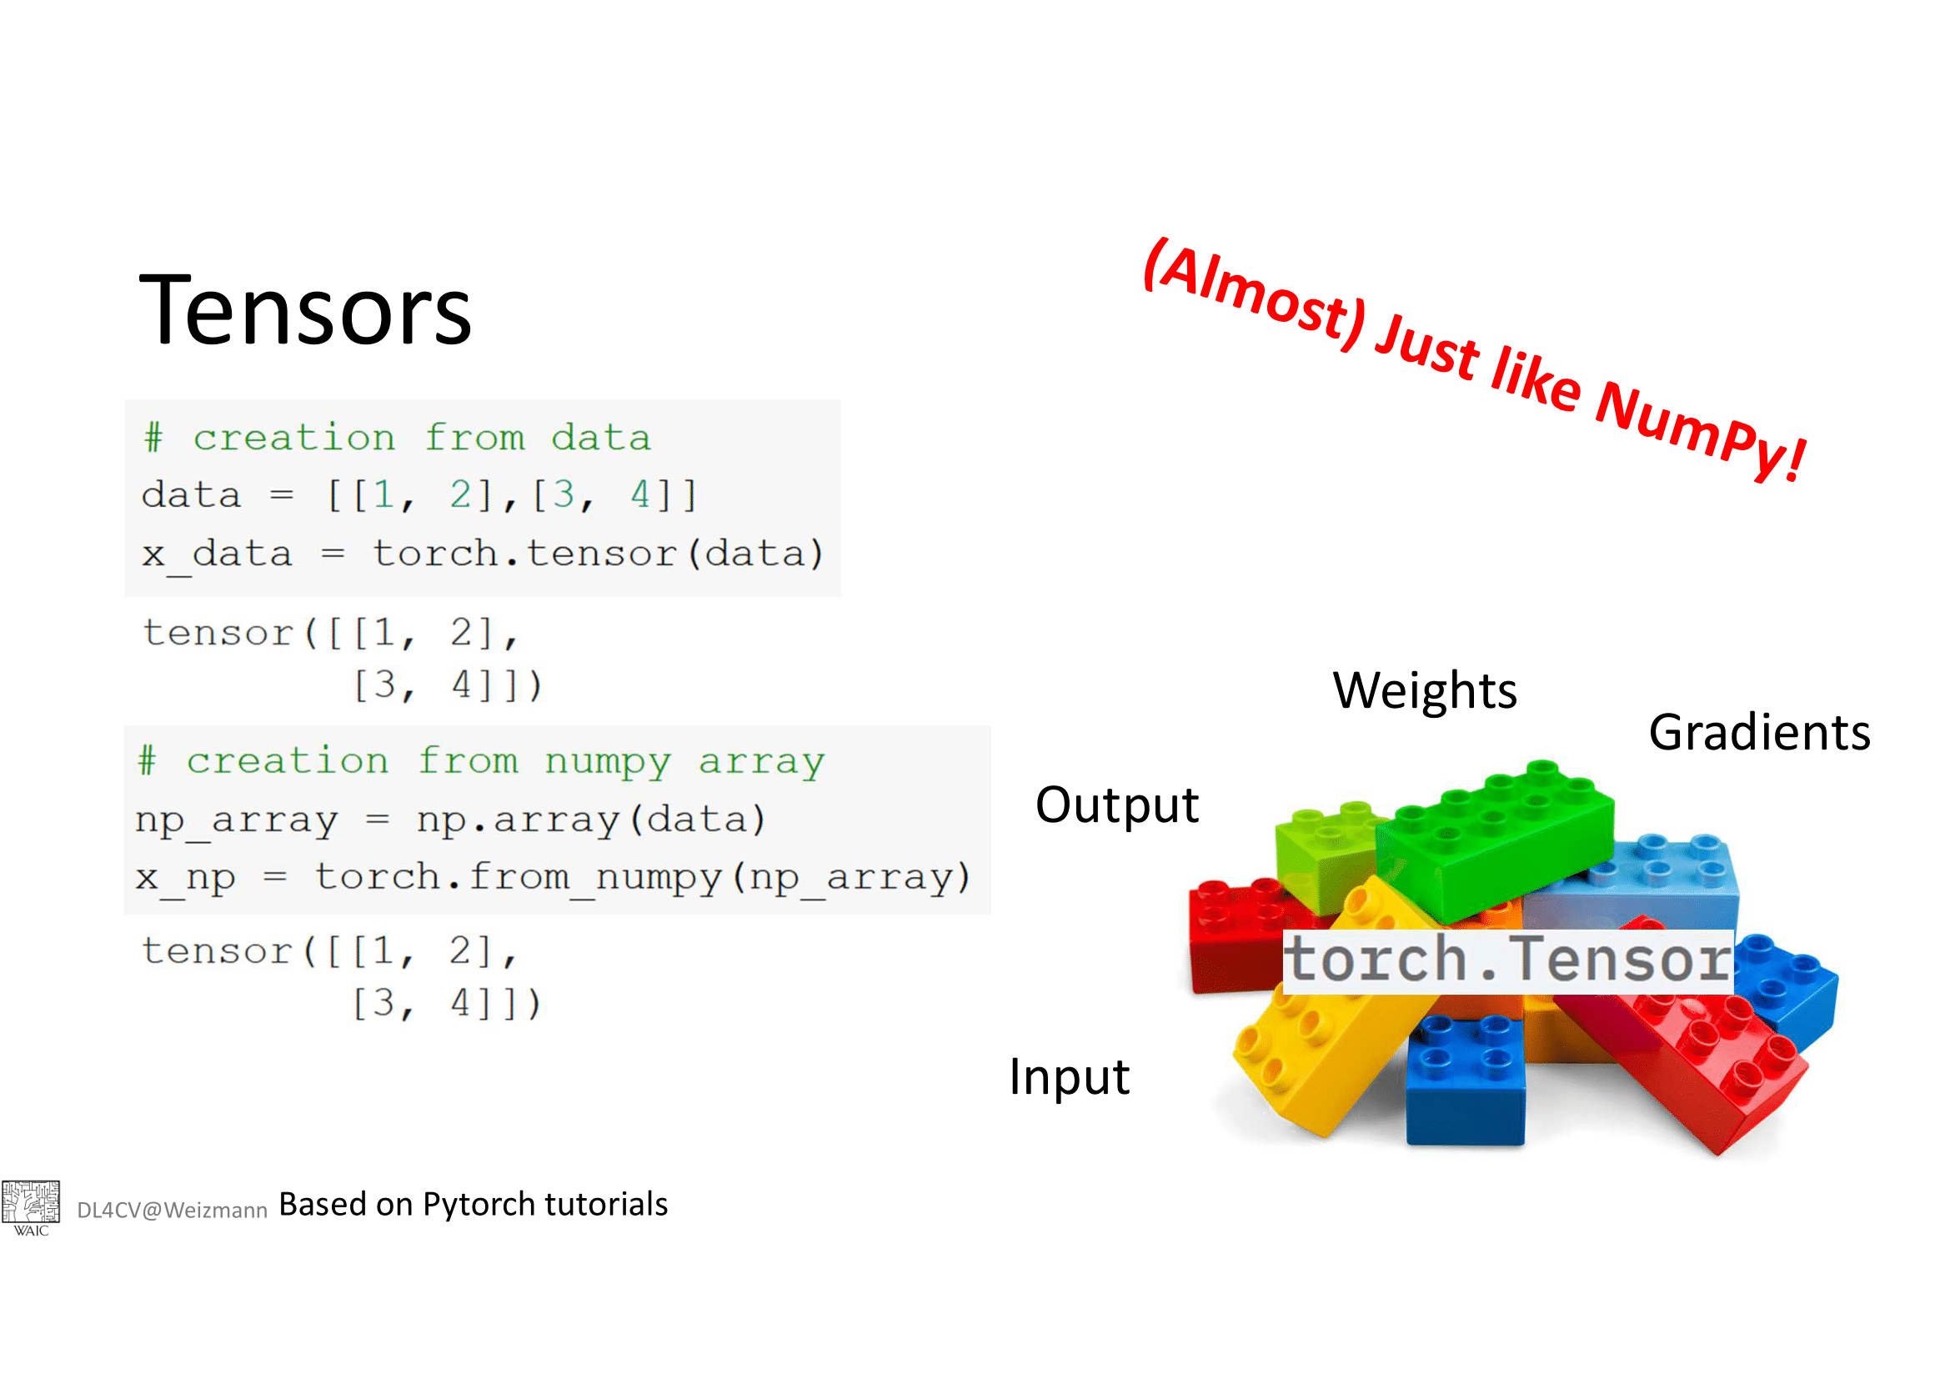

Slide 5
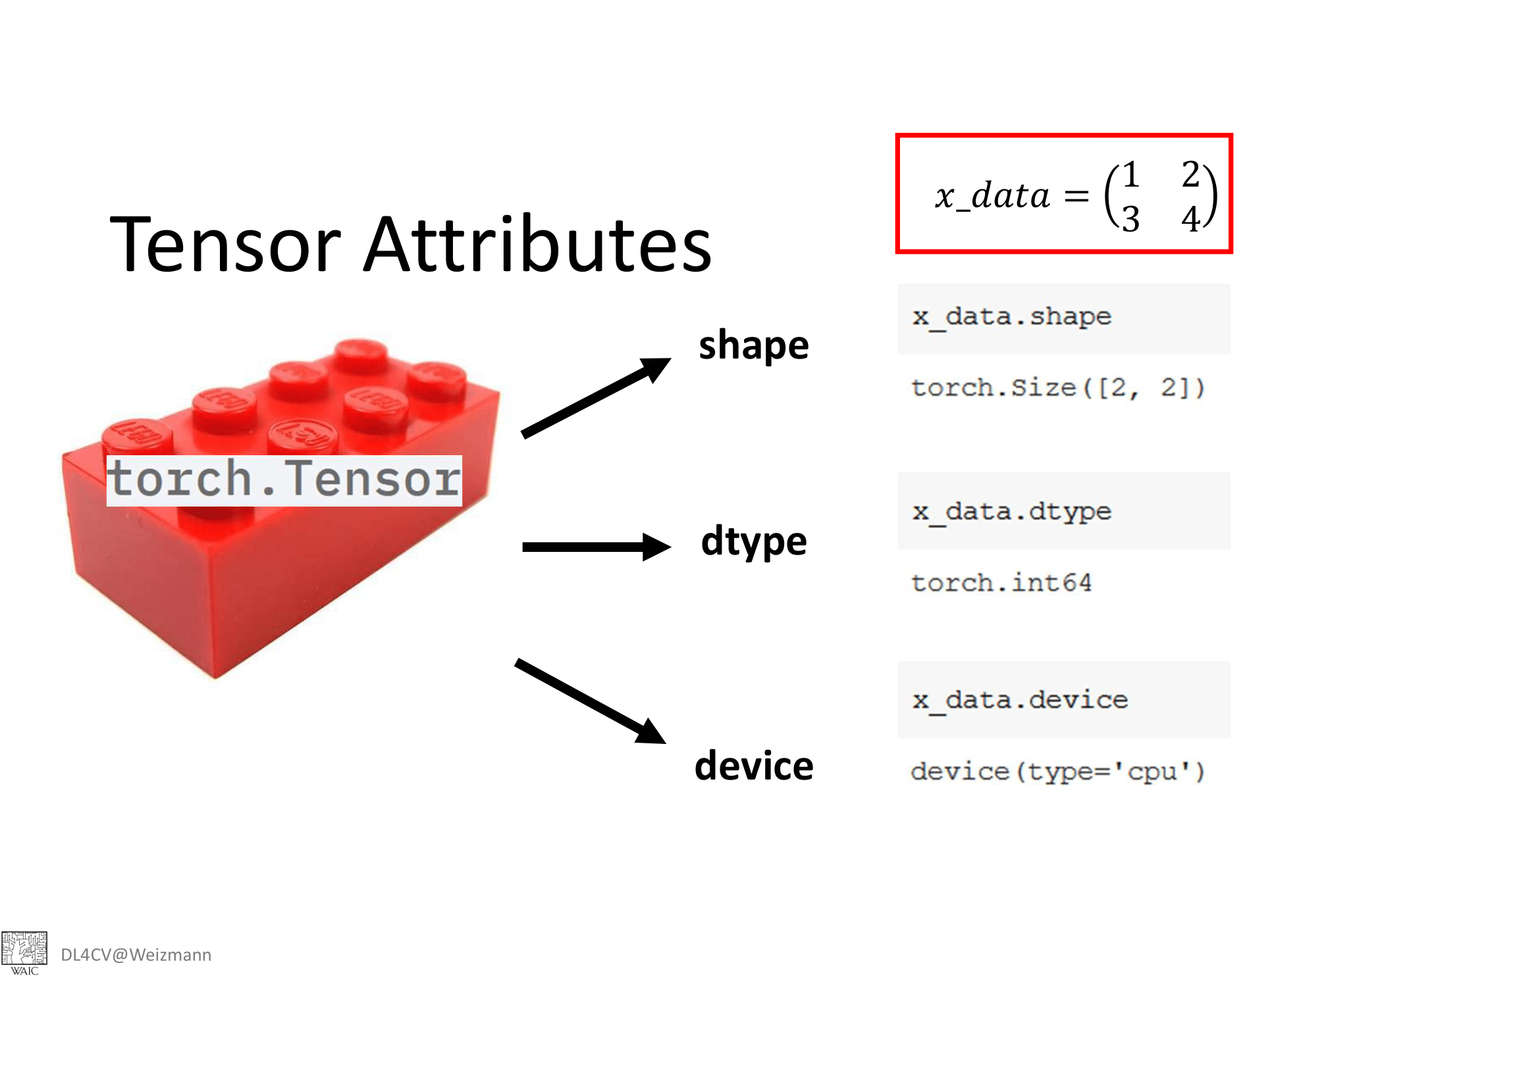

Slide 6
Using GPU on Google Colab
Go to Edit-> Notebook Settings
From the dropdown menu “Hardware accelerator” select GPU
Now you can use GPU on Google Colab

Slide 7
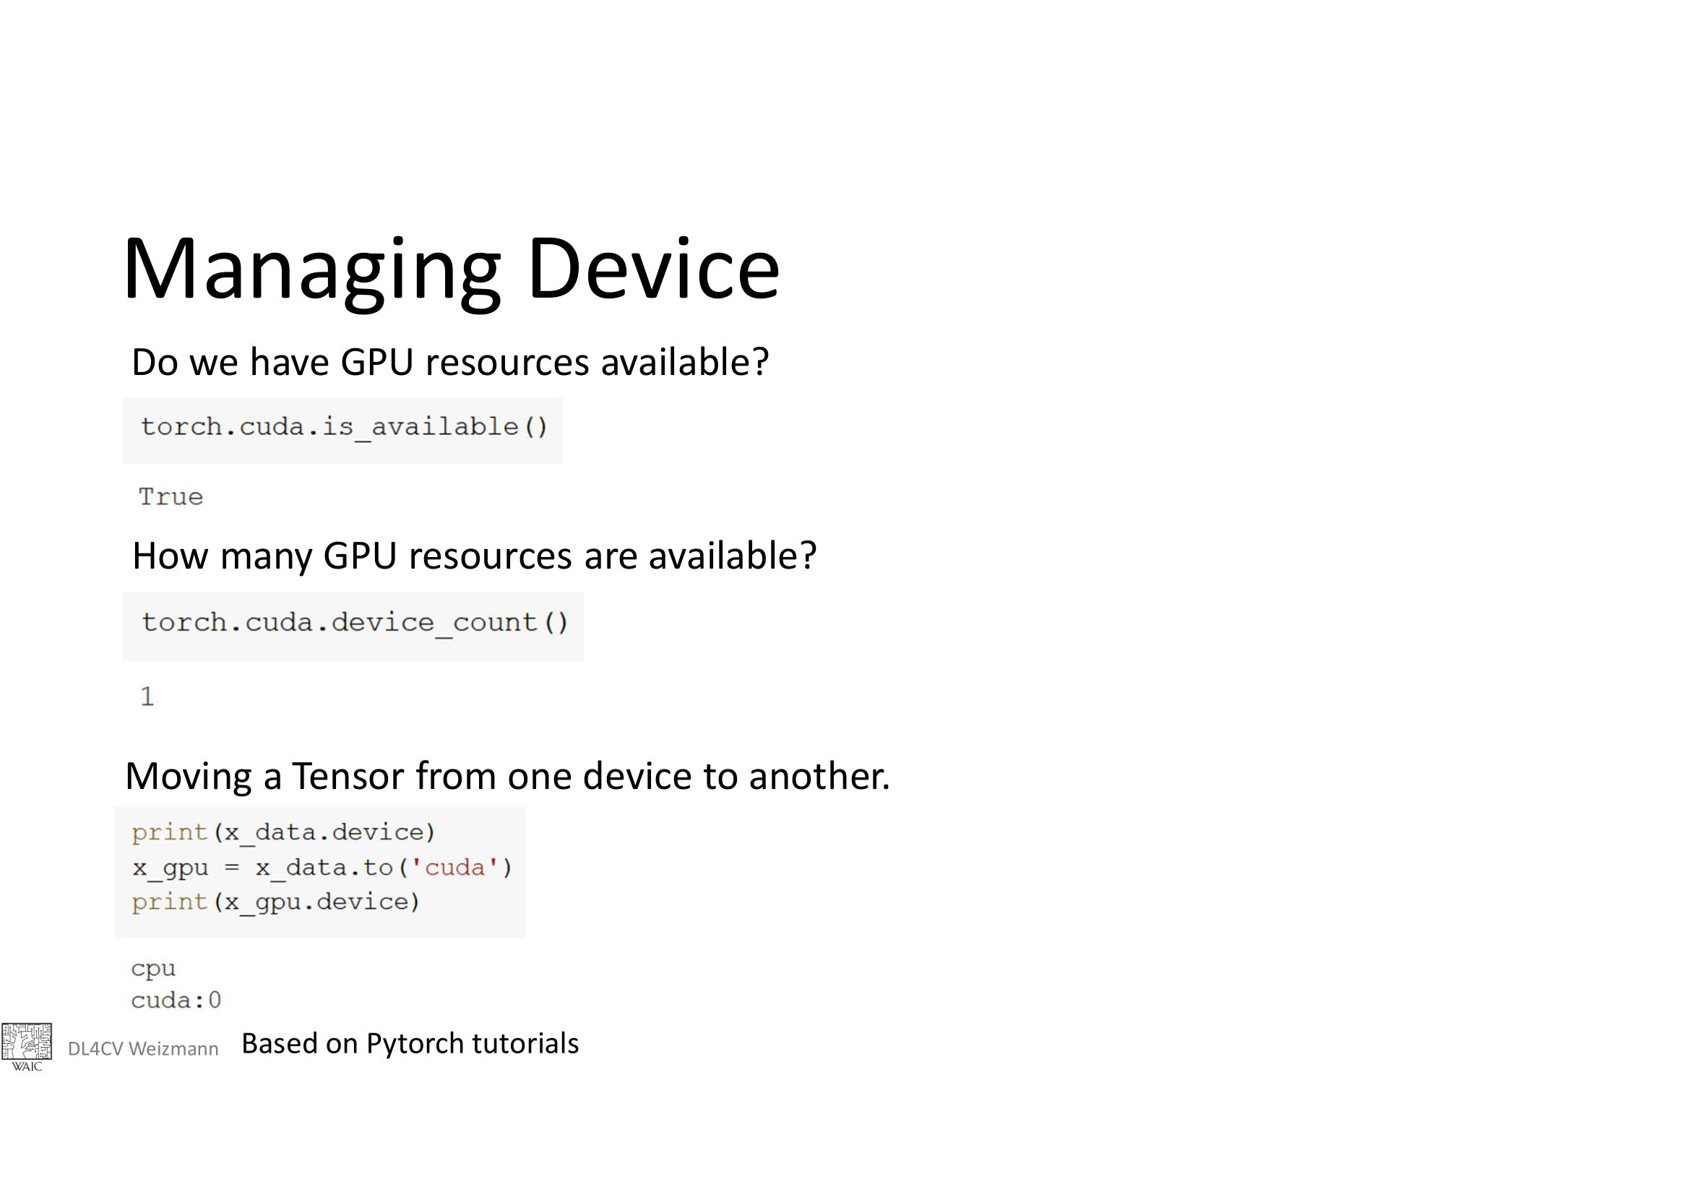

Slide 8
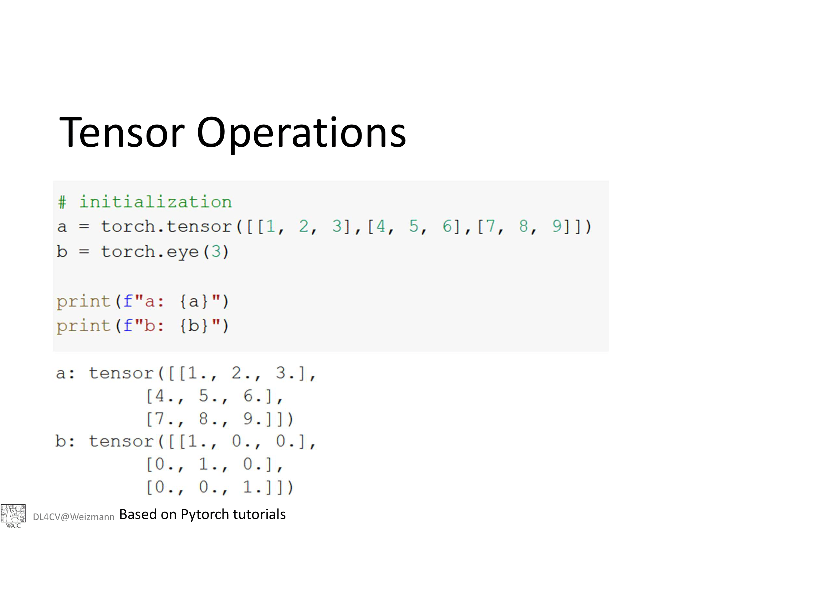

Slide 9
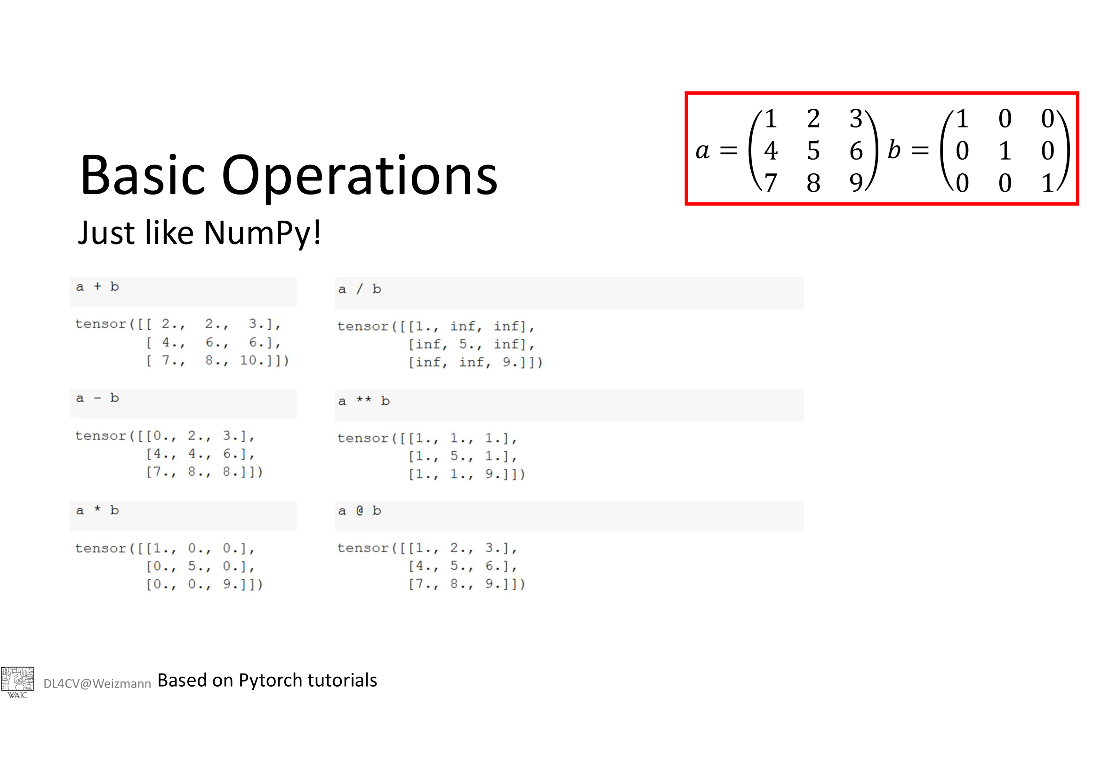

Slide 10
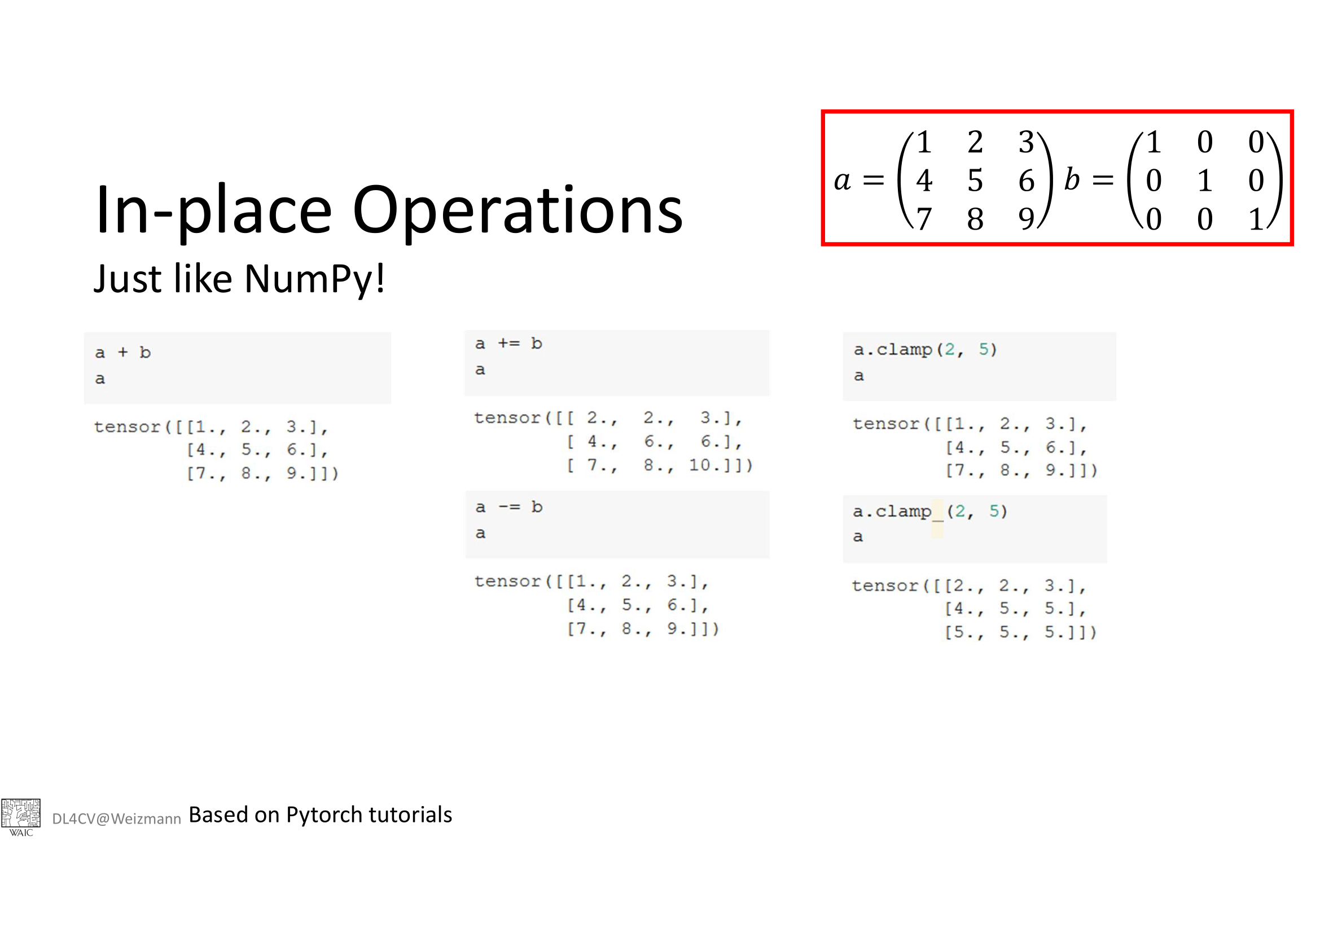

Slide 11
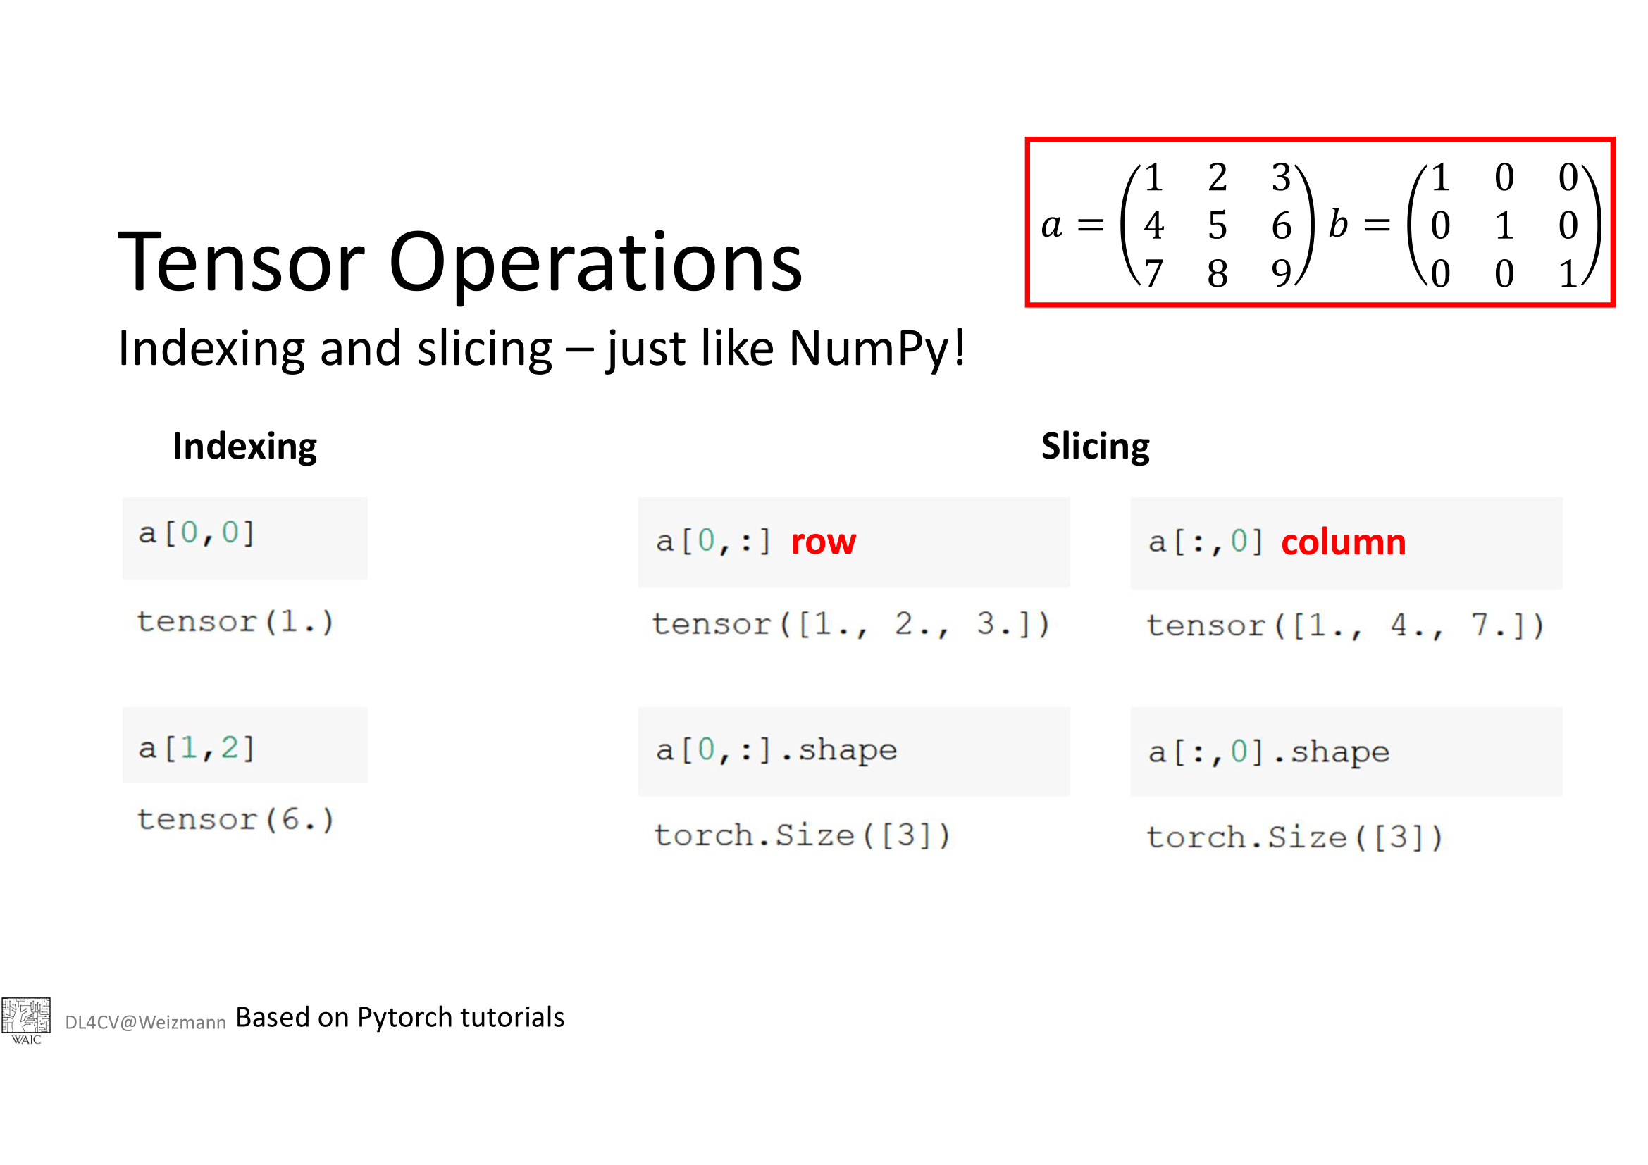

Slide 12
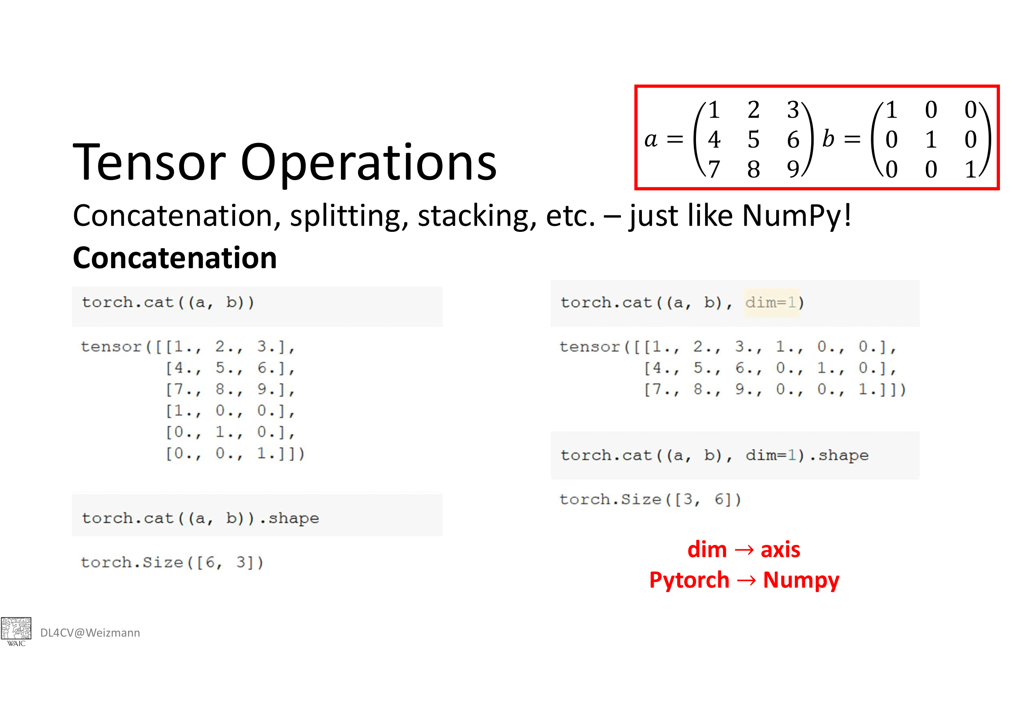

Slide 13
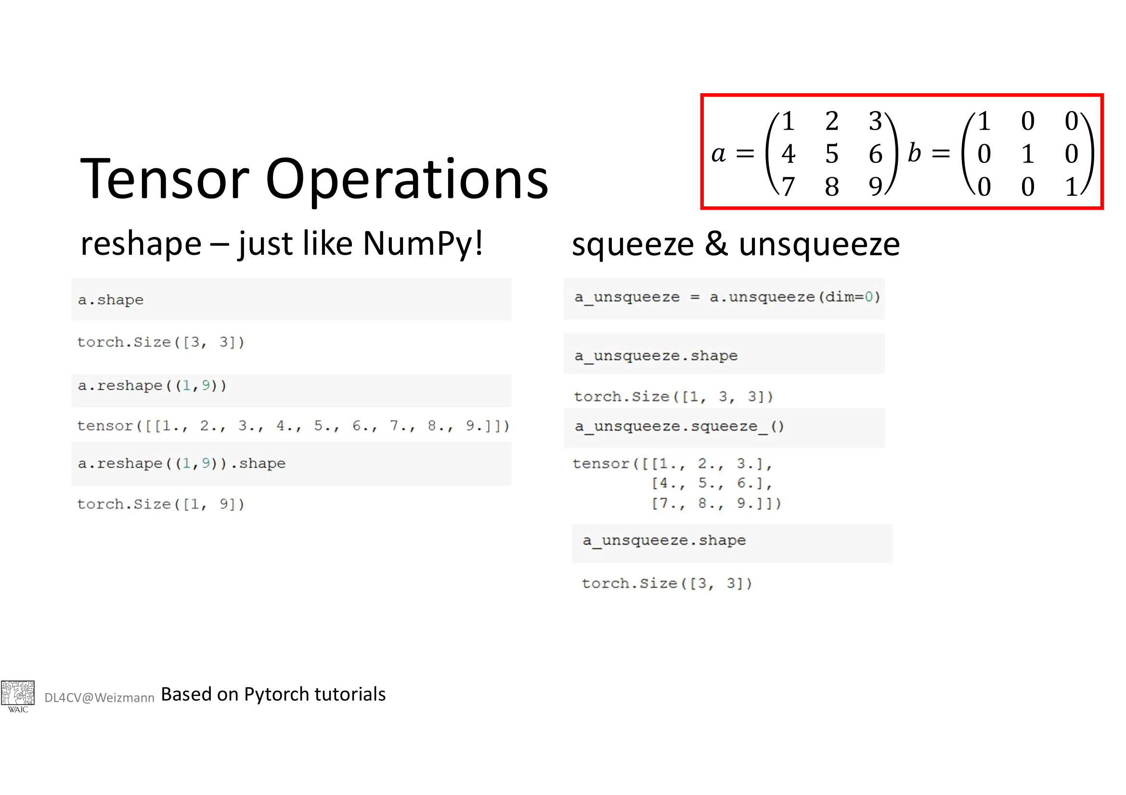
Also try a.view(-1,9)
a.view(3,-1)
a.view(3,3,-1)

Slide 14
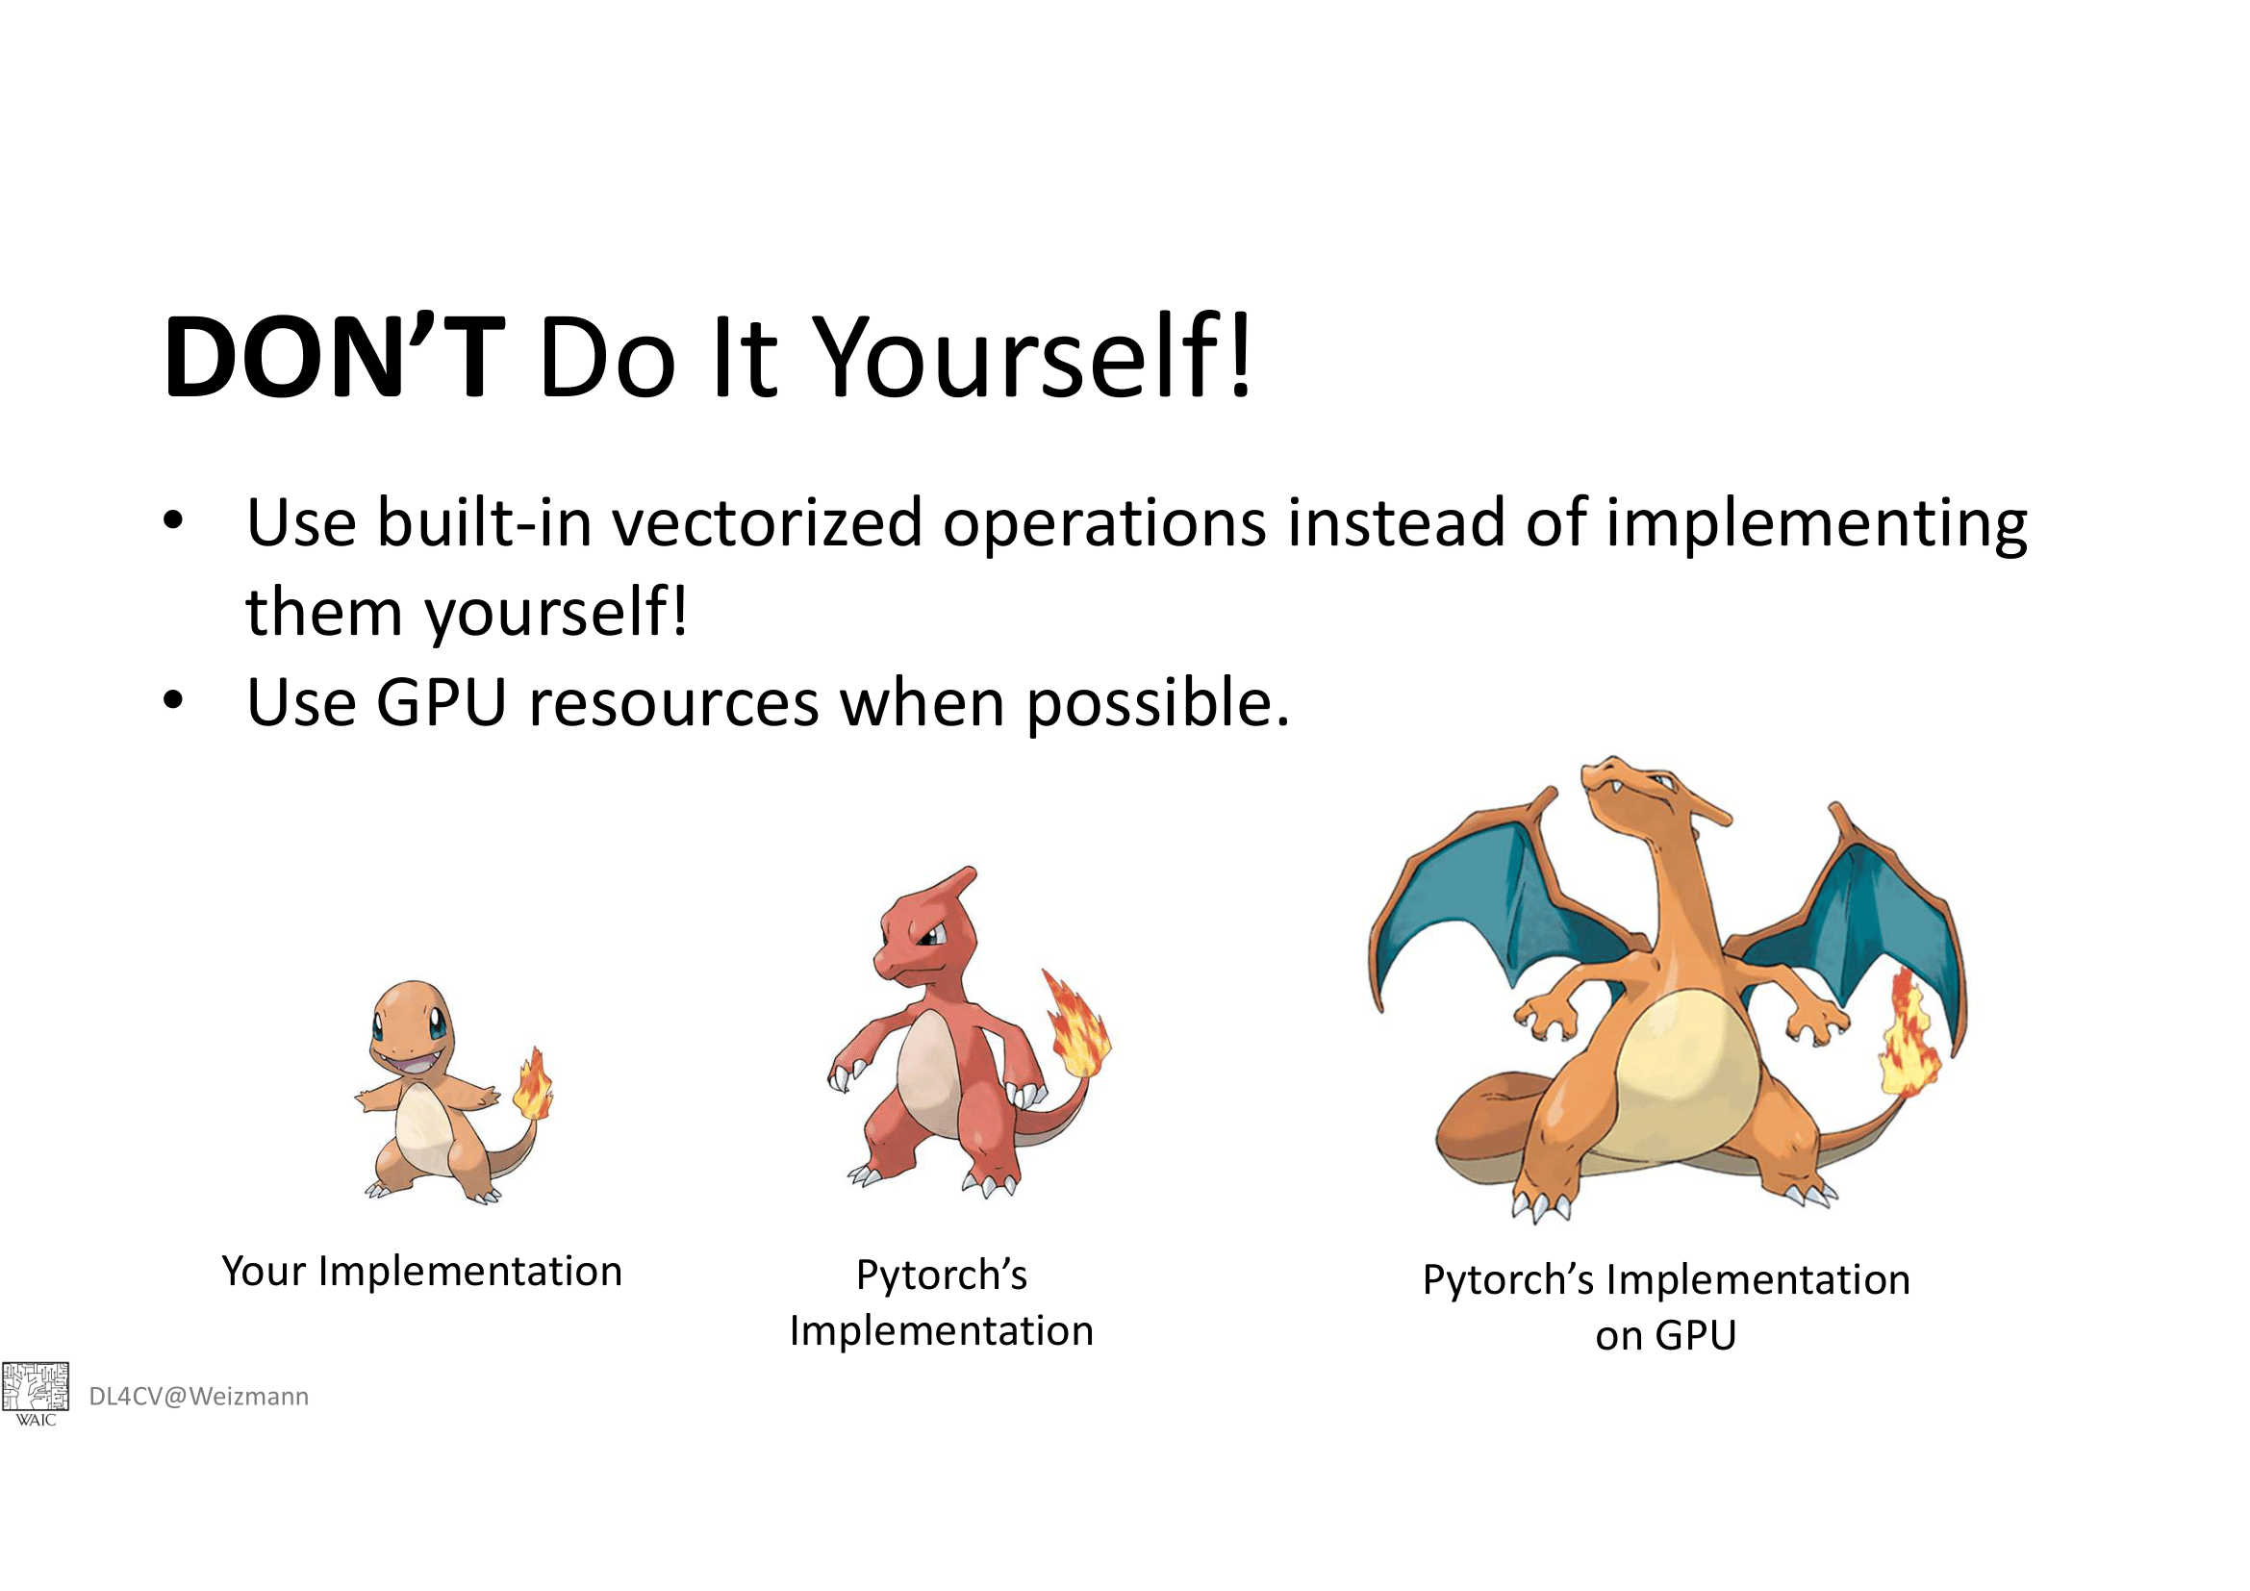

Slide 15
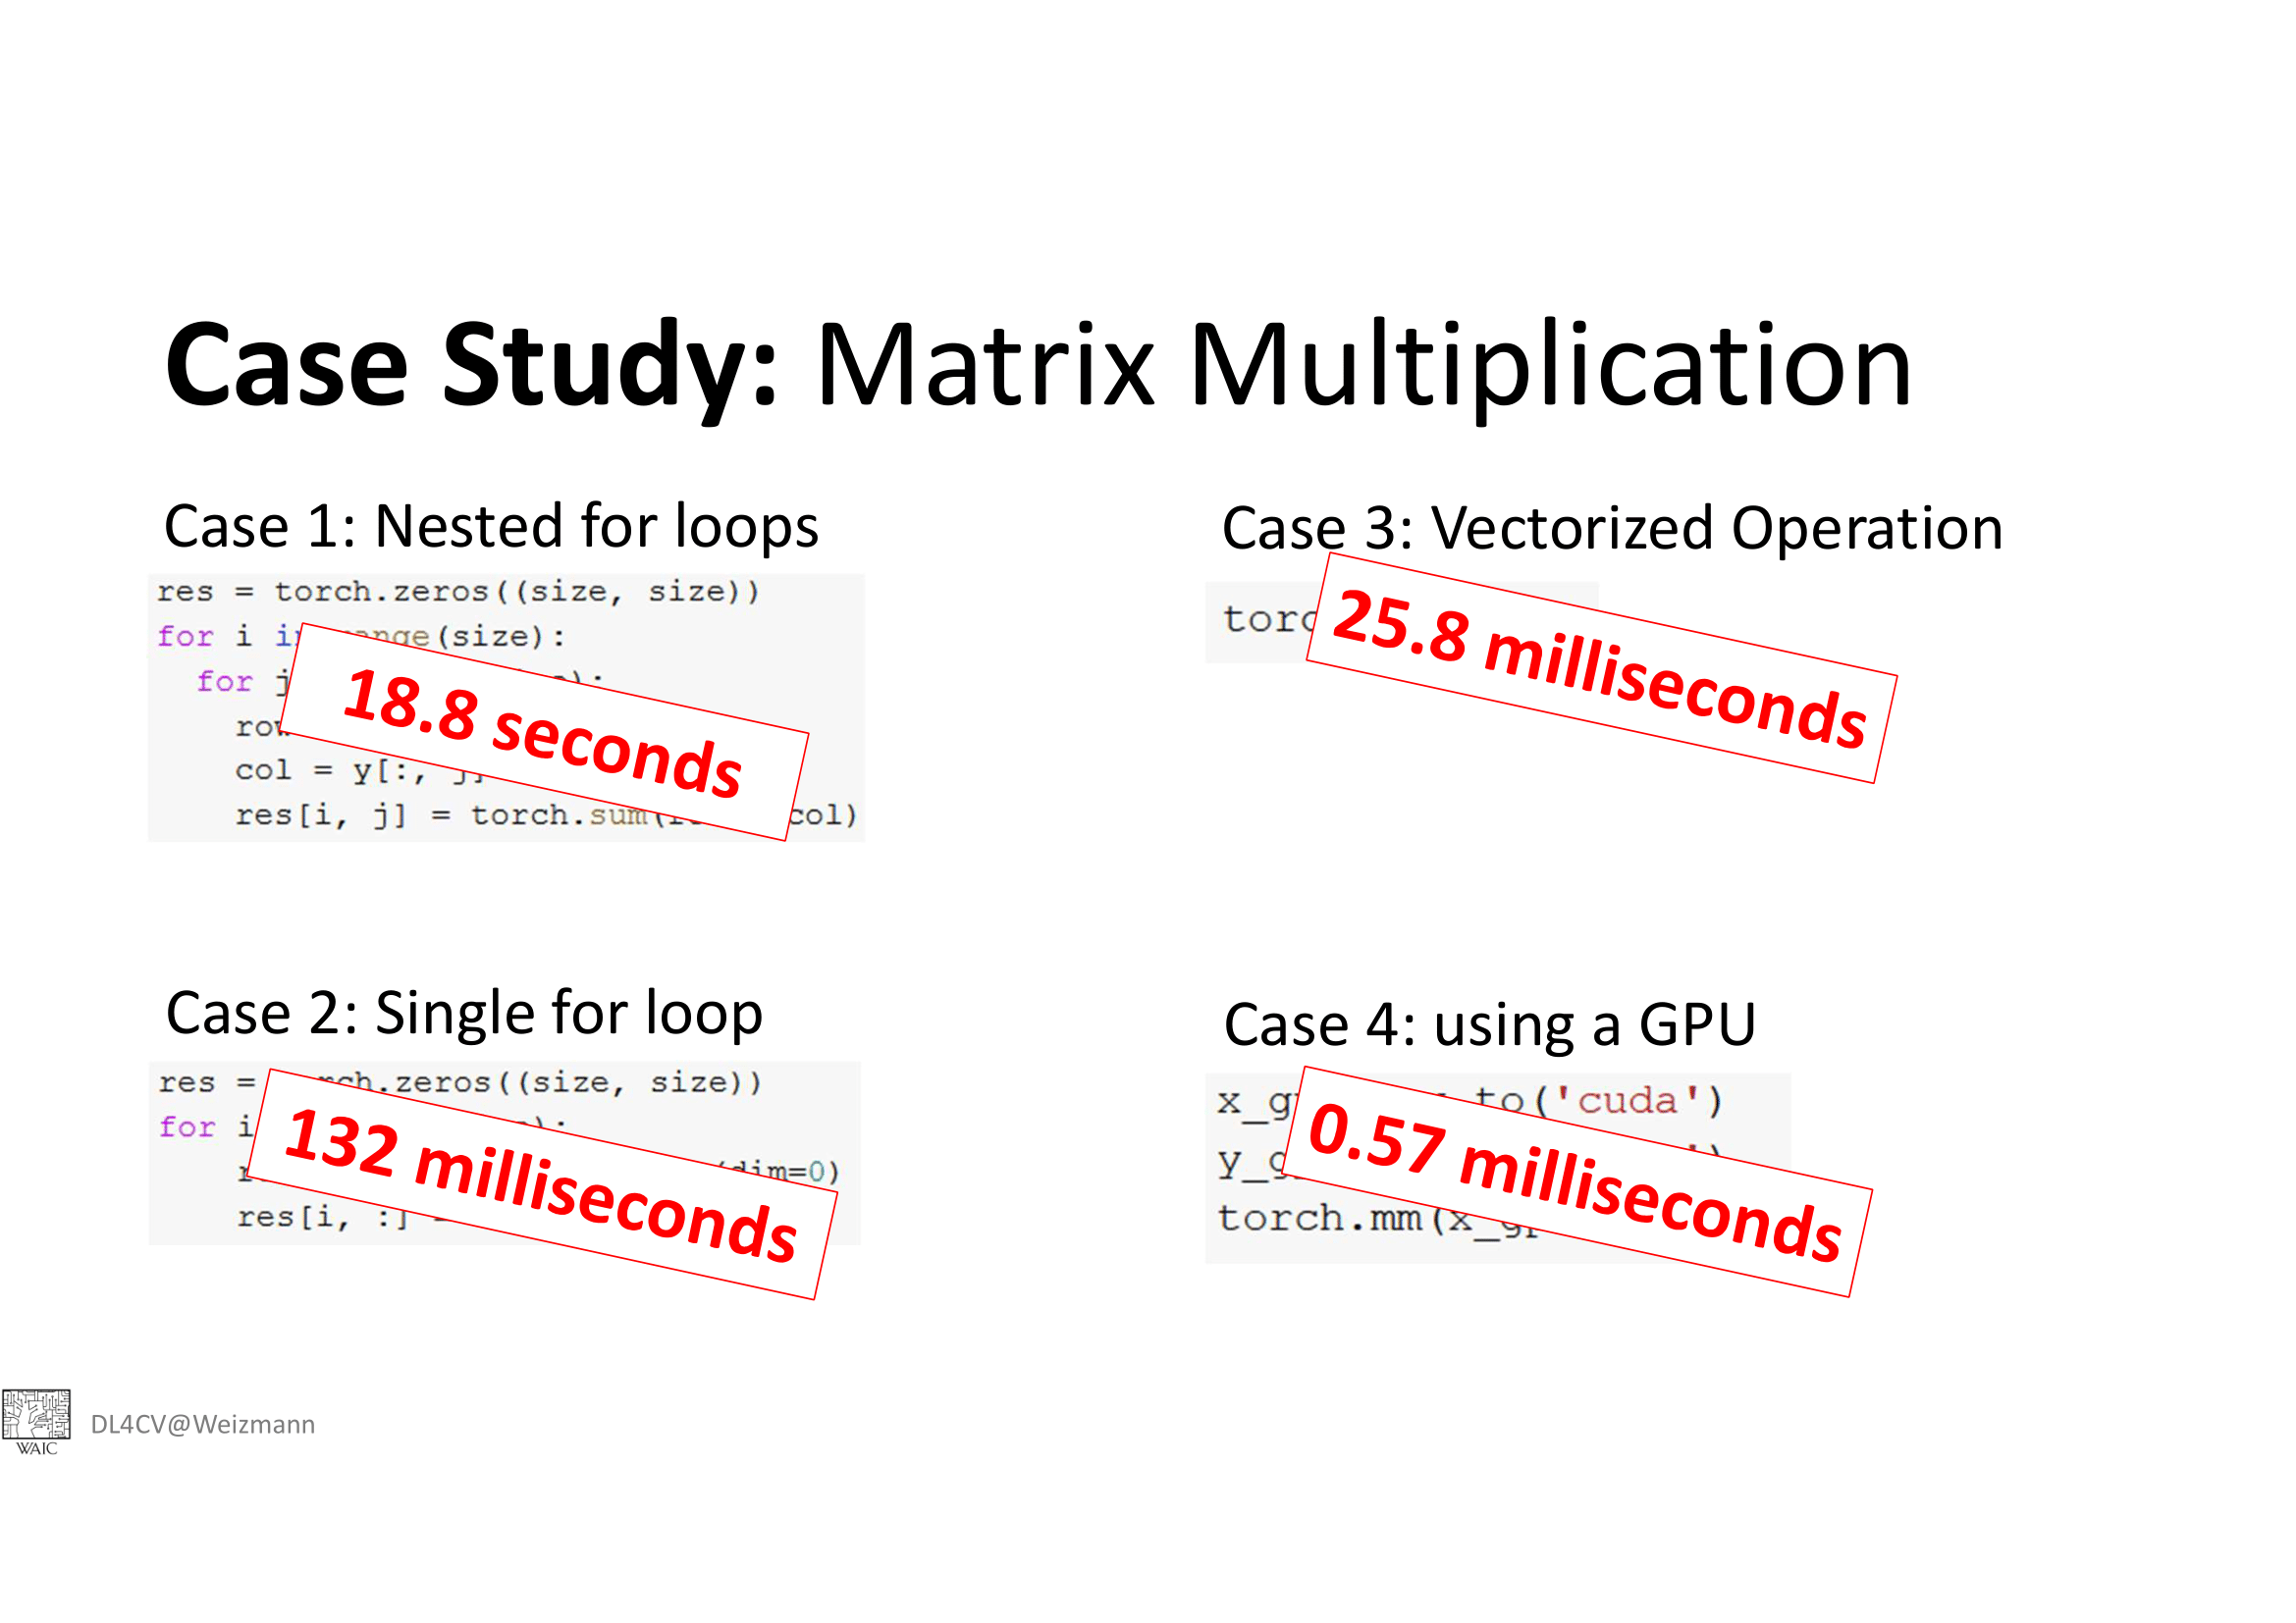

Slide 16
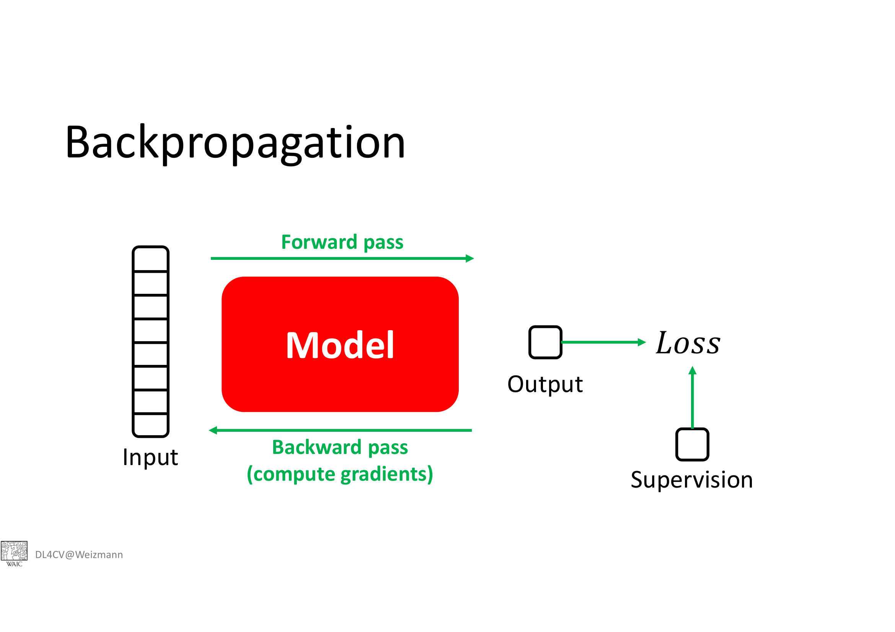

Slide 17
Building a NN yourself:
Go to Google Colab titled: MNIST_NN_Numpy
And run the code
The code trains a 2 layer NN on MNIST dataset in numpy
Identify different blocks of code, for farword pass, gradient calcuation, optimization setp etc

Slide 18
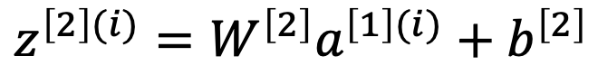
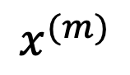
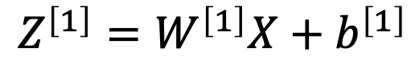
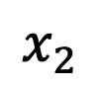
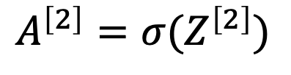
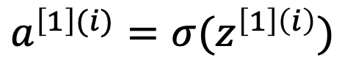
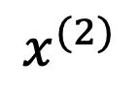
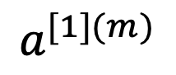
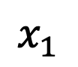
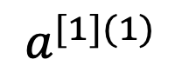
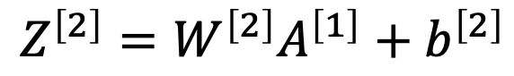
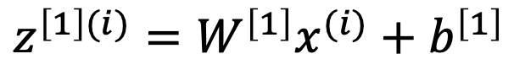
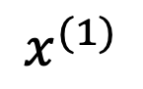
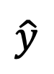
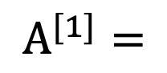
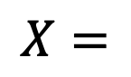
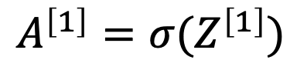
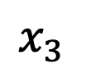
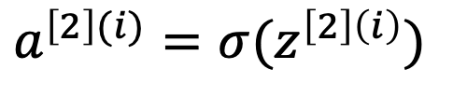
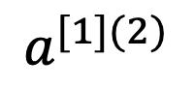
Neural Networks Implementation Details (Forward Pass+Vectorization)
for i = 1 to m
$$x_{1}$$
$$z^{\left[1\right](i)}=W^{\left[1\right]}x^{(i)}+b^{\left[1\right]}$$
$$x_{2}$$
$$\hat{y}$$
$$a^{\left[1\right](i)}=σ(z^{\left[1\right]\left(i\right)})$$
$$x_{3}$$
$$z^{\left[2\right](i)}=W^{\left[2\right]}a^{\left[1\right](i)}+b^{\left[2\right]}$$
$$a^{\left[2\right](i)}=σ(z^{\left[2\right]\left(i\right)})$$
$$X=$$
$$x^{(1)}$$
$$x^{(2)}$$
…
$$x^{(m)}$$
$$Z^{\left[1\right]}=W^{\left[1\right]}X+b^{\left[1\right]}$$
$$A^{\left[1\right]}=σ(Z^{\left[1\right]})$$
$$Z^{\left[2\right]}=W^{\left[2\right]}A^{\left[1\right]}+b^{\left[2\right]}$$
$A^{[1]}=$
$$a^{[1](1)}$$
$$a^{[1](2)}$$
…
$$a^{[1](m)}$$
$$A^{\left[2\right]}=σ(Z^{\left[2\right]})$$
Slide from: deeplearning.ai

Slide 19
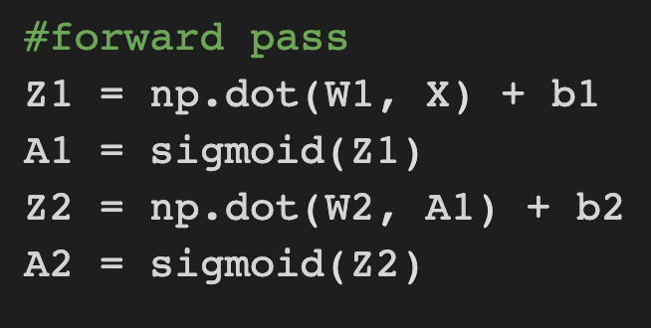
Forward Pass

Slide 20
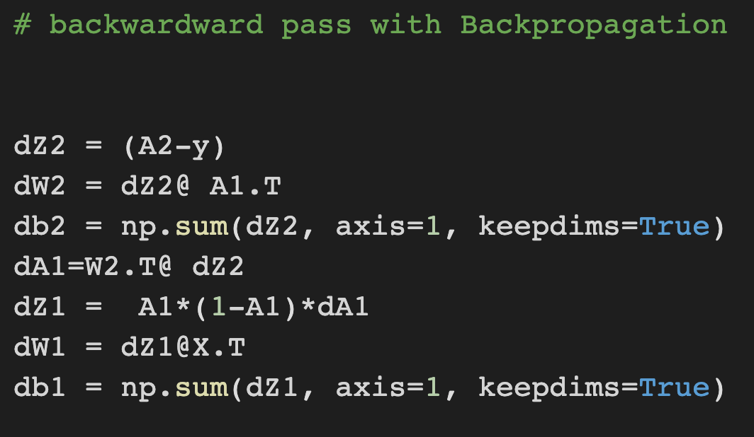
Gradient Calculation

Slide 21
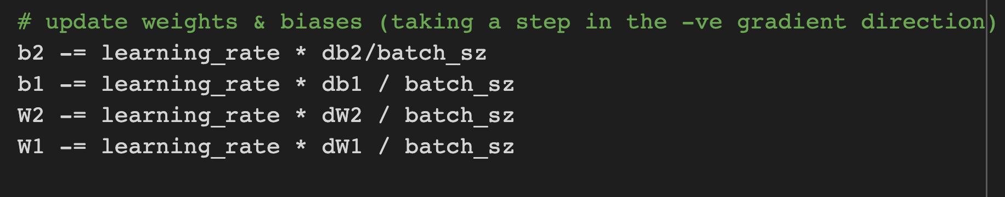
Batch Gradient Descent

Slide 22
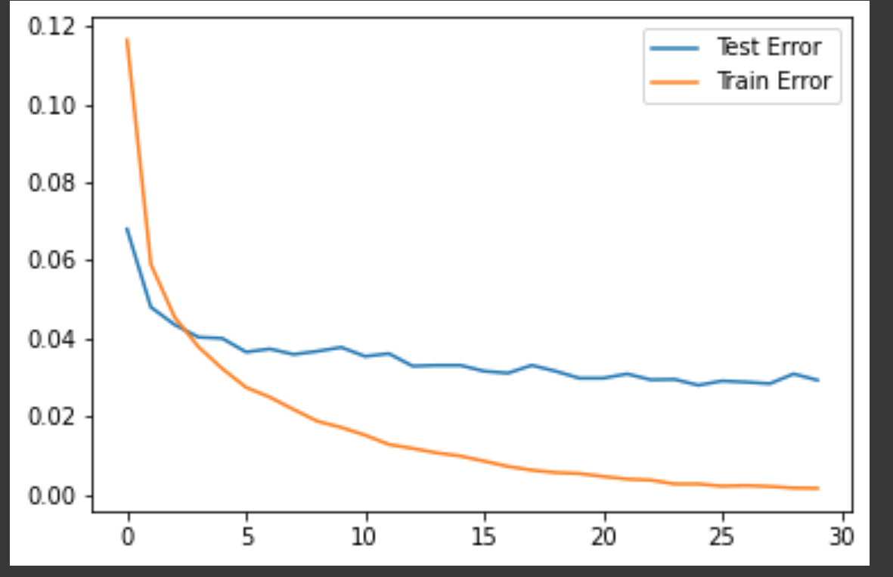
Training and Validation loss plots

Slide 23
ATTENTION (IMPORTANT DETAIL)
In most books/courses of ML/DL a linear layer is written like
W*X+b
In PyTorch and indeed other DL libraries a linear layer is
X*W^{T}+b
You need to be aware of the change of dimensions of W and output

Slide 24
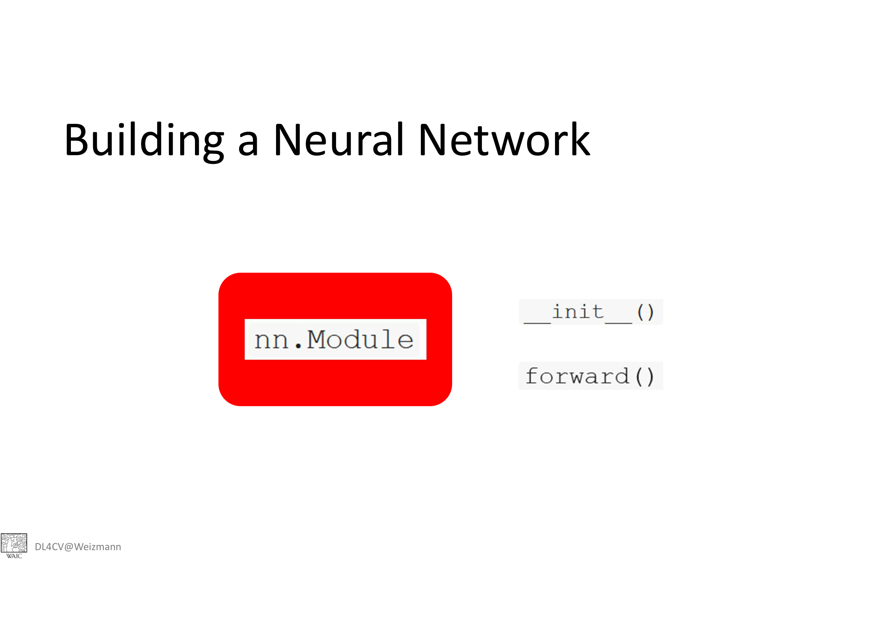

Slide 25
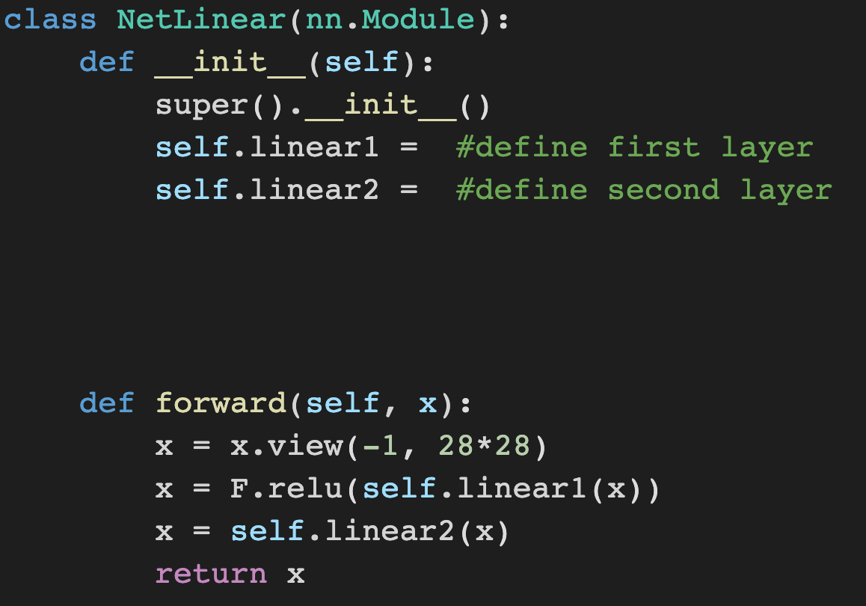
Defining the Network

Slide 26
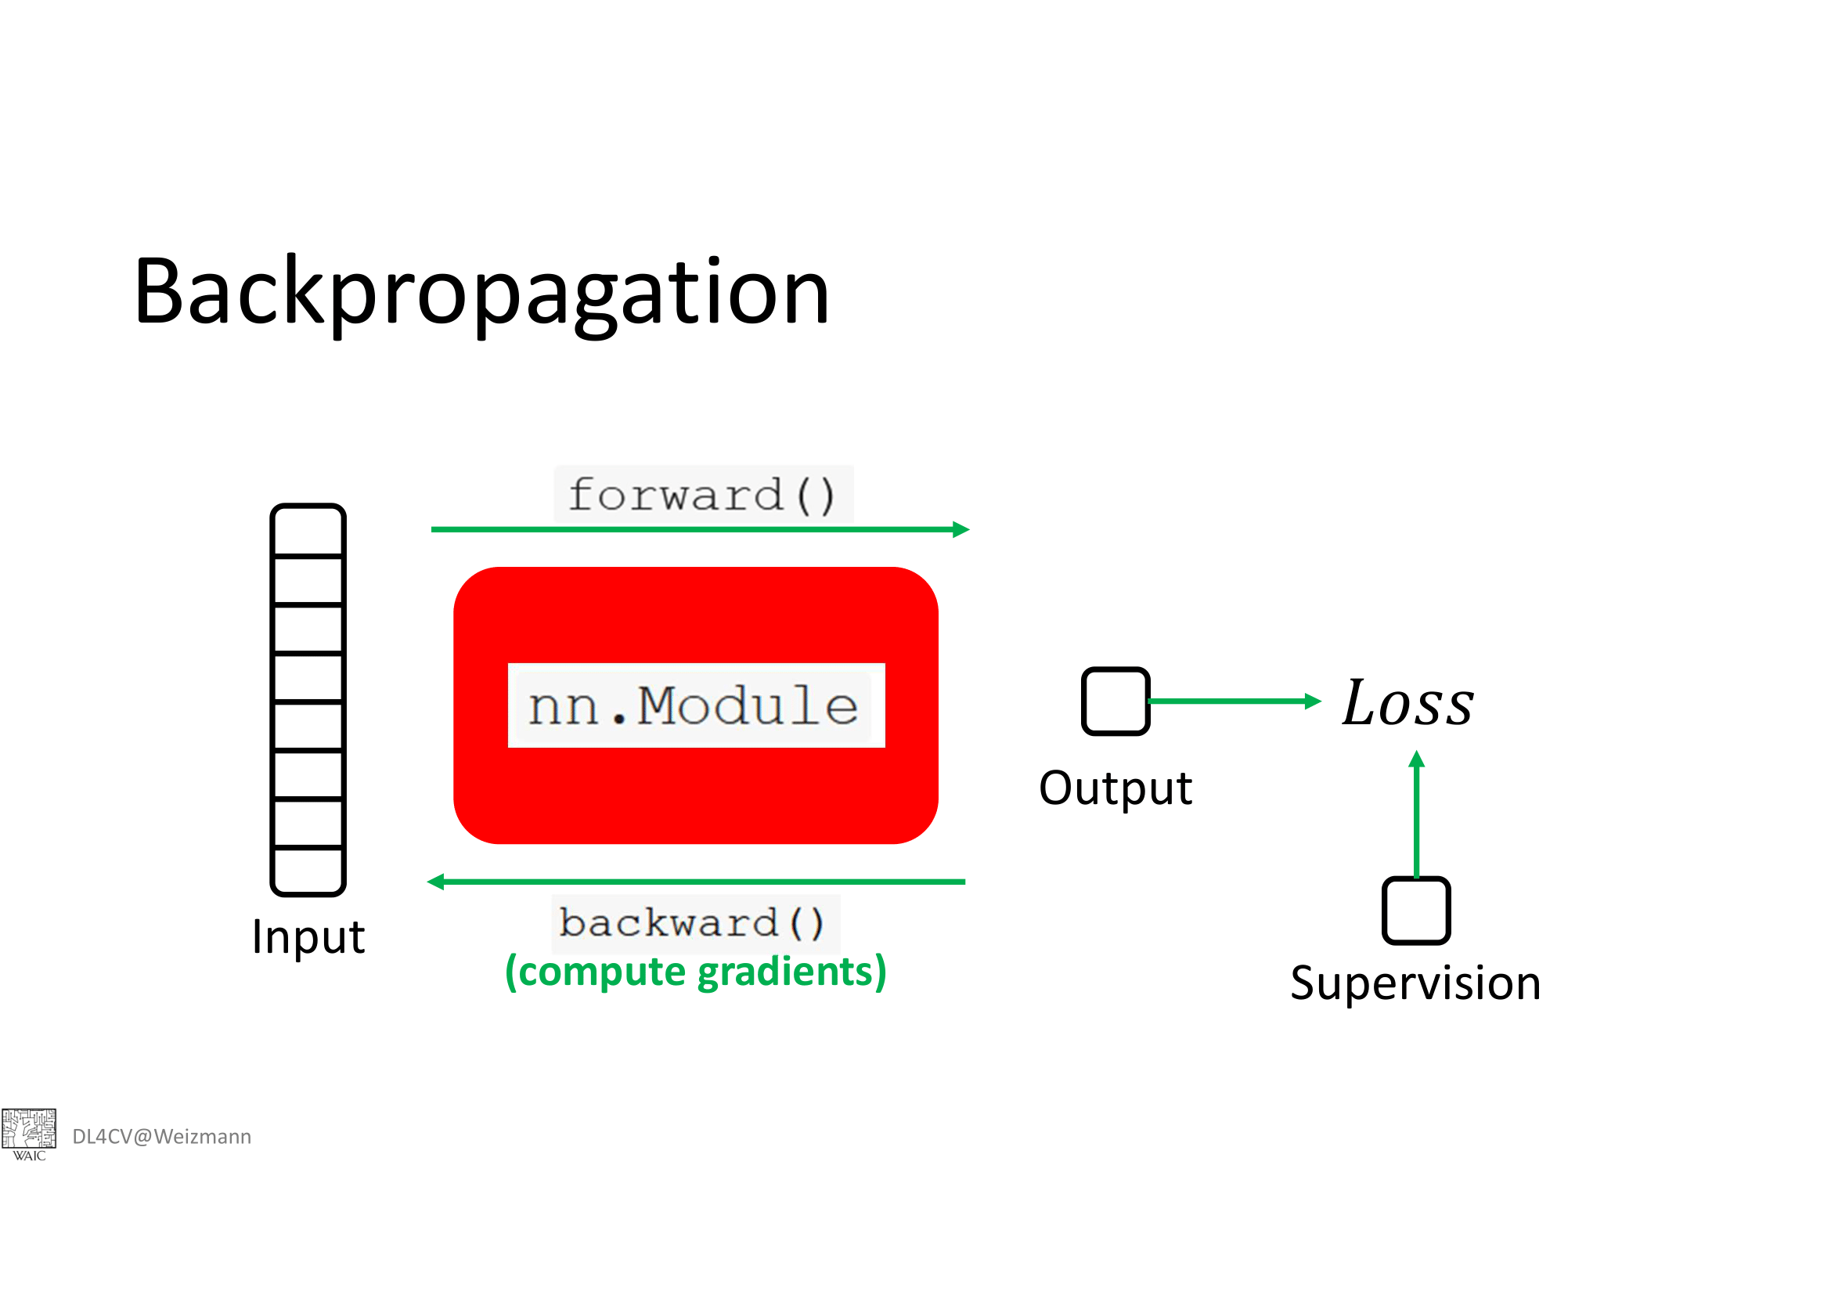

Slide 27
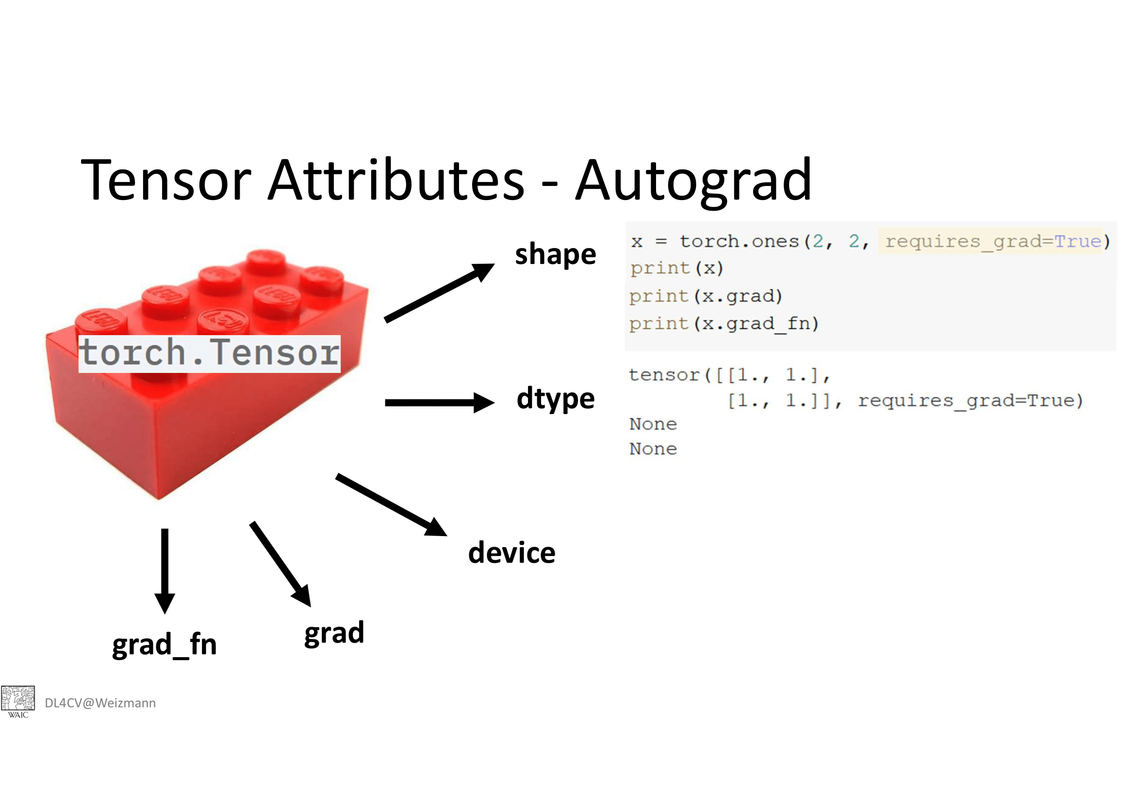

Slide 28
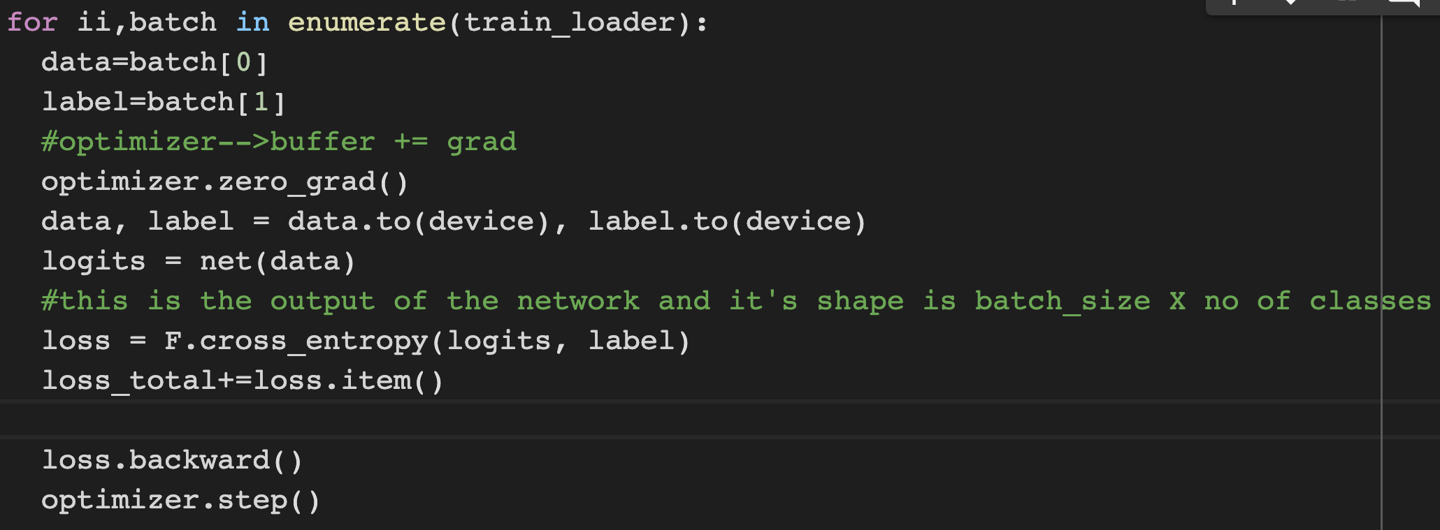
Training Loop

Slide 29
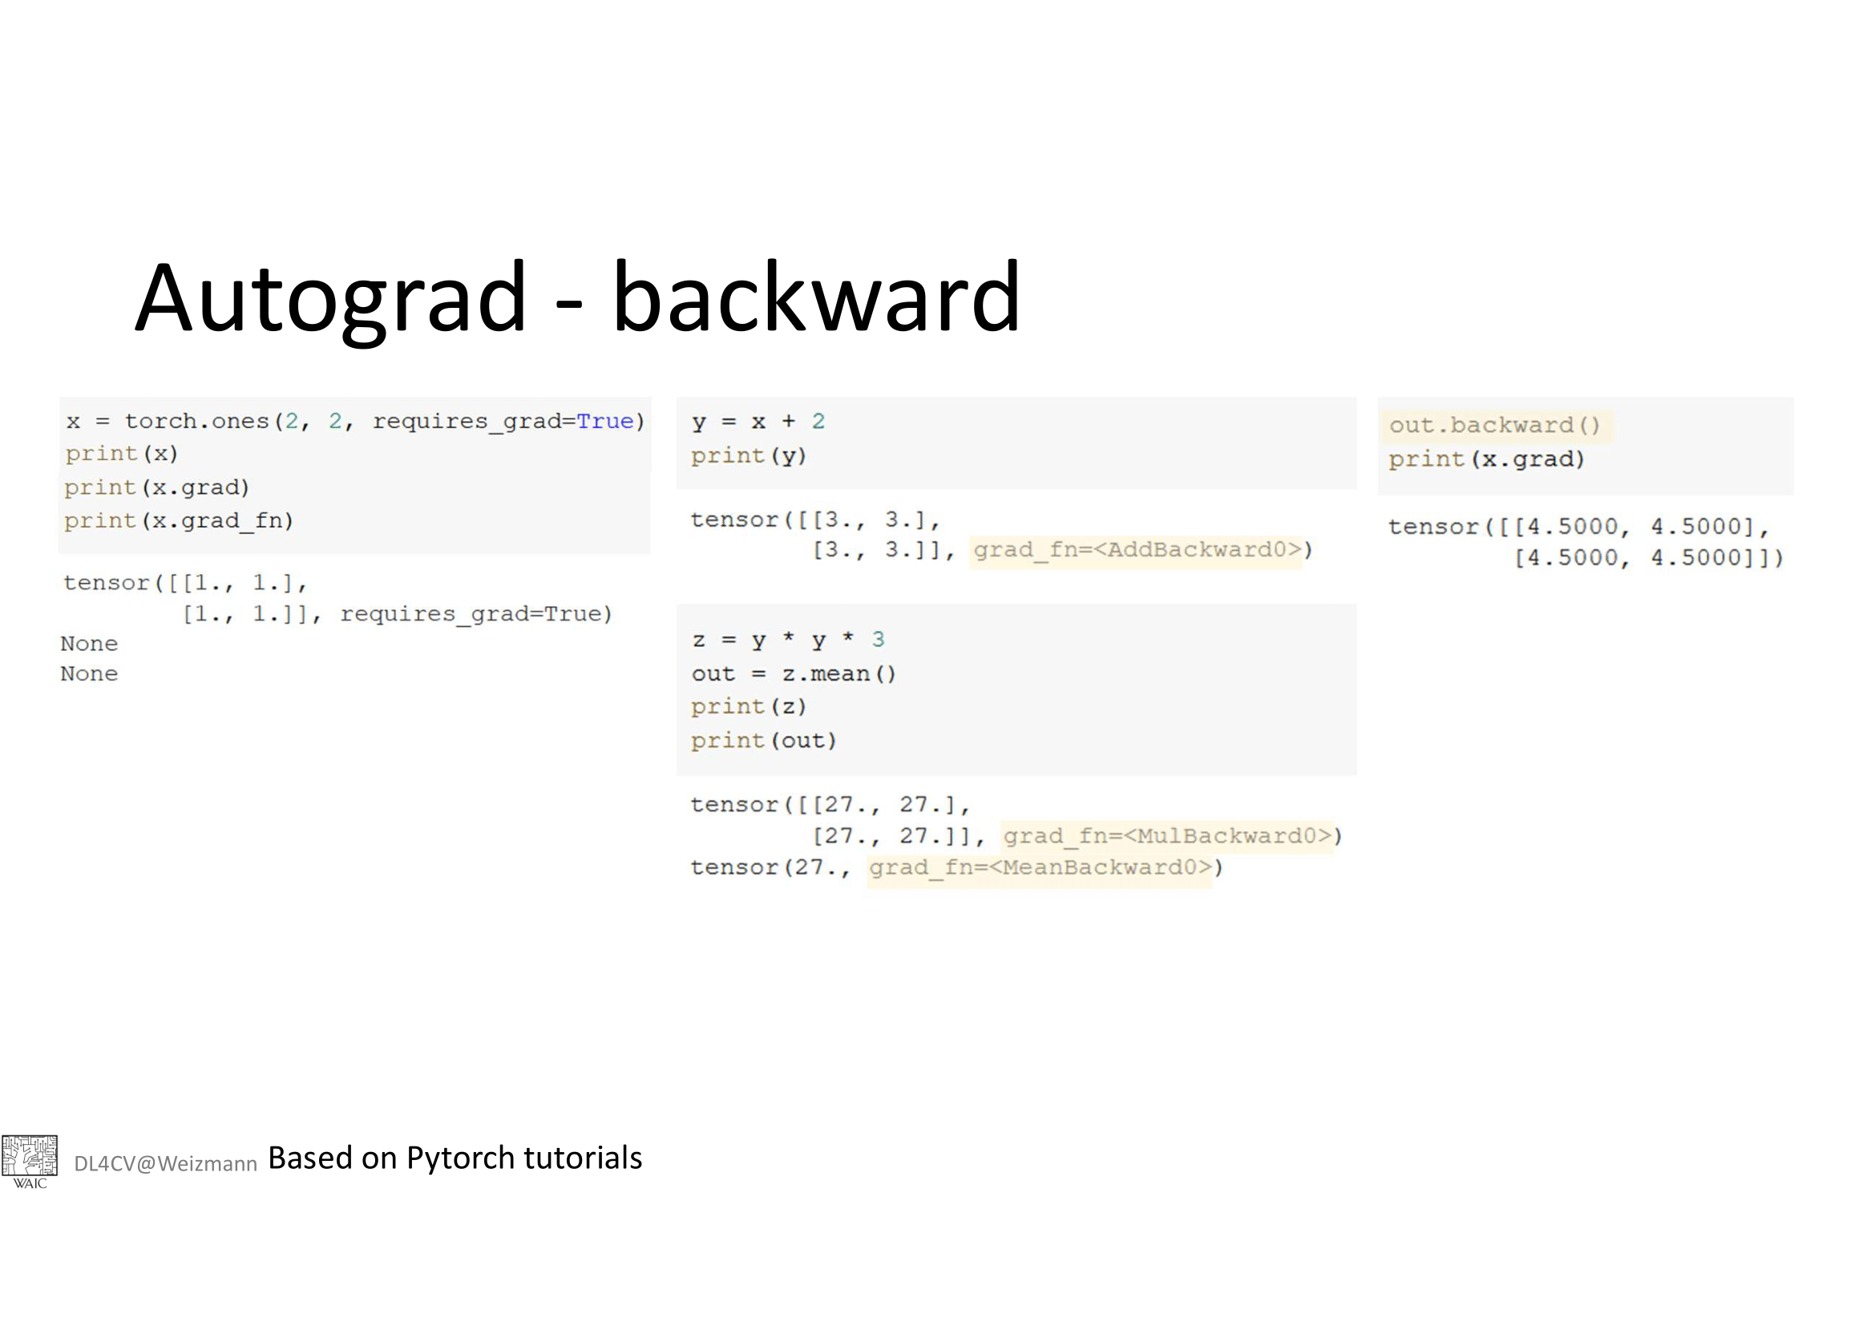

Slide 30
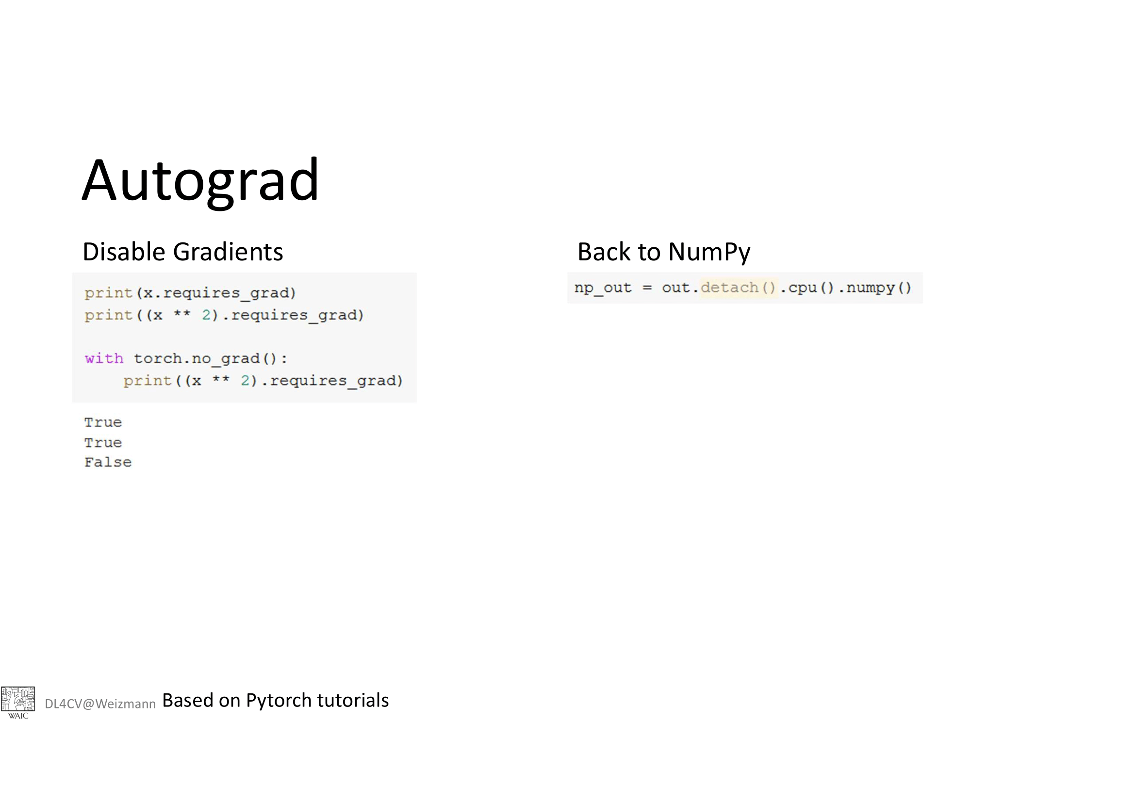

Slide 31
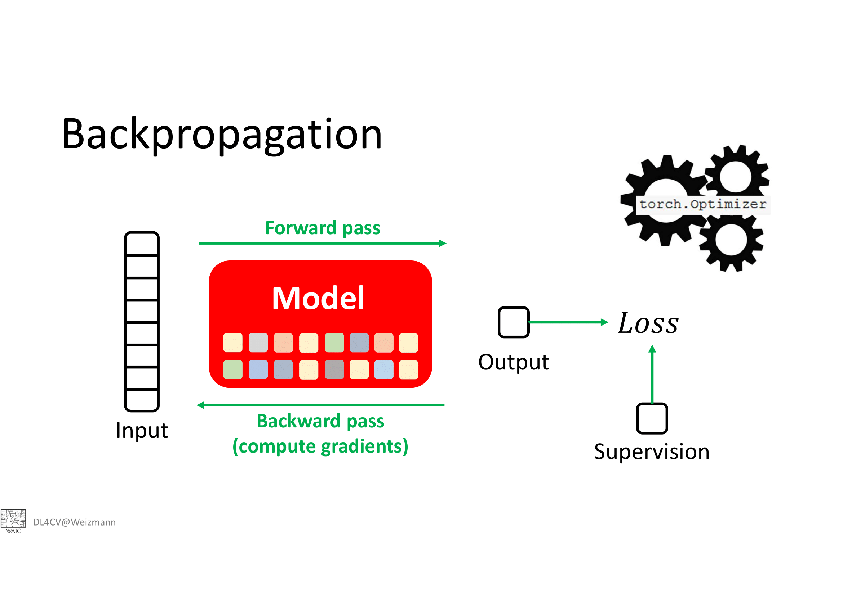

Slide 32
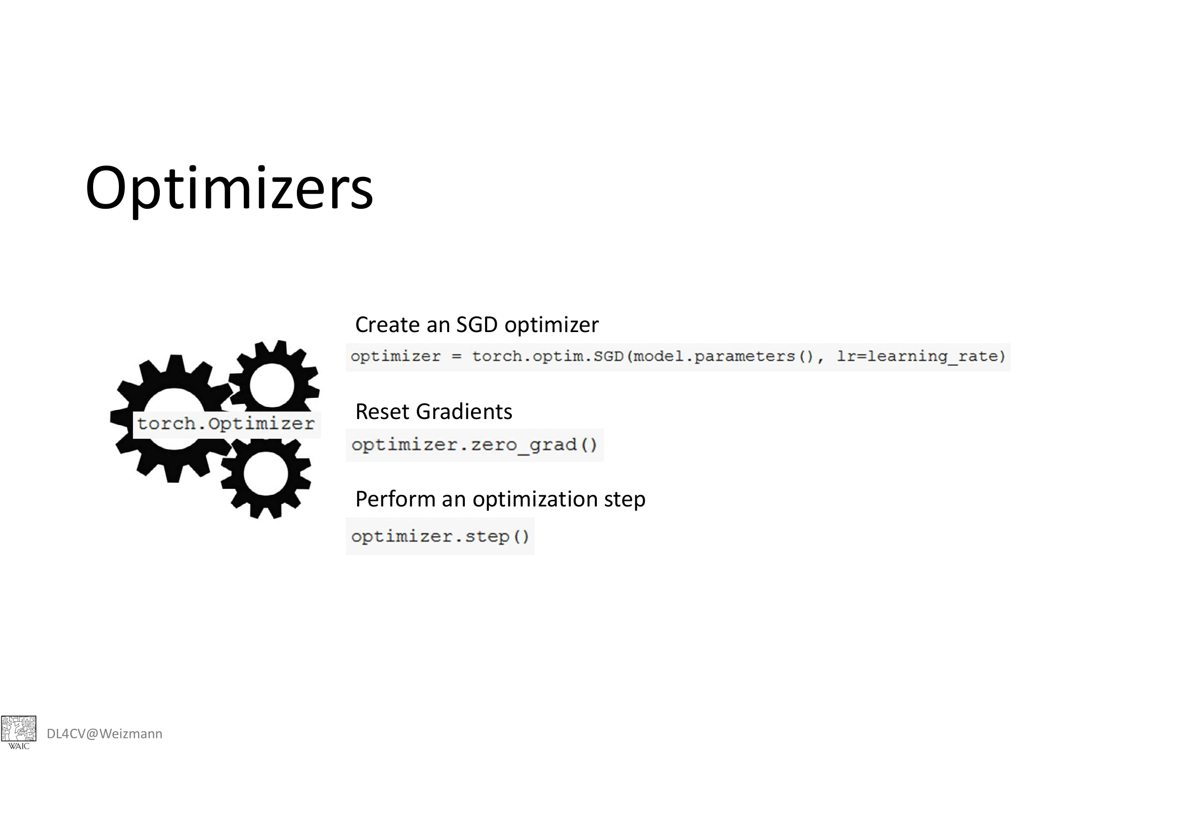

Slide 33
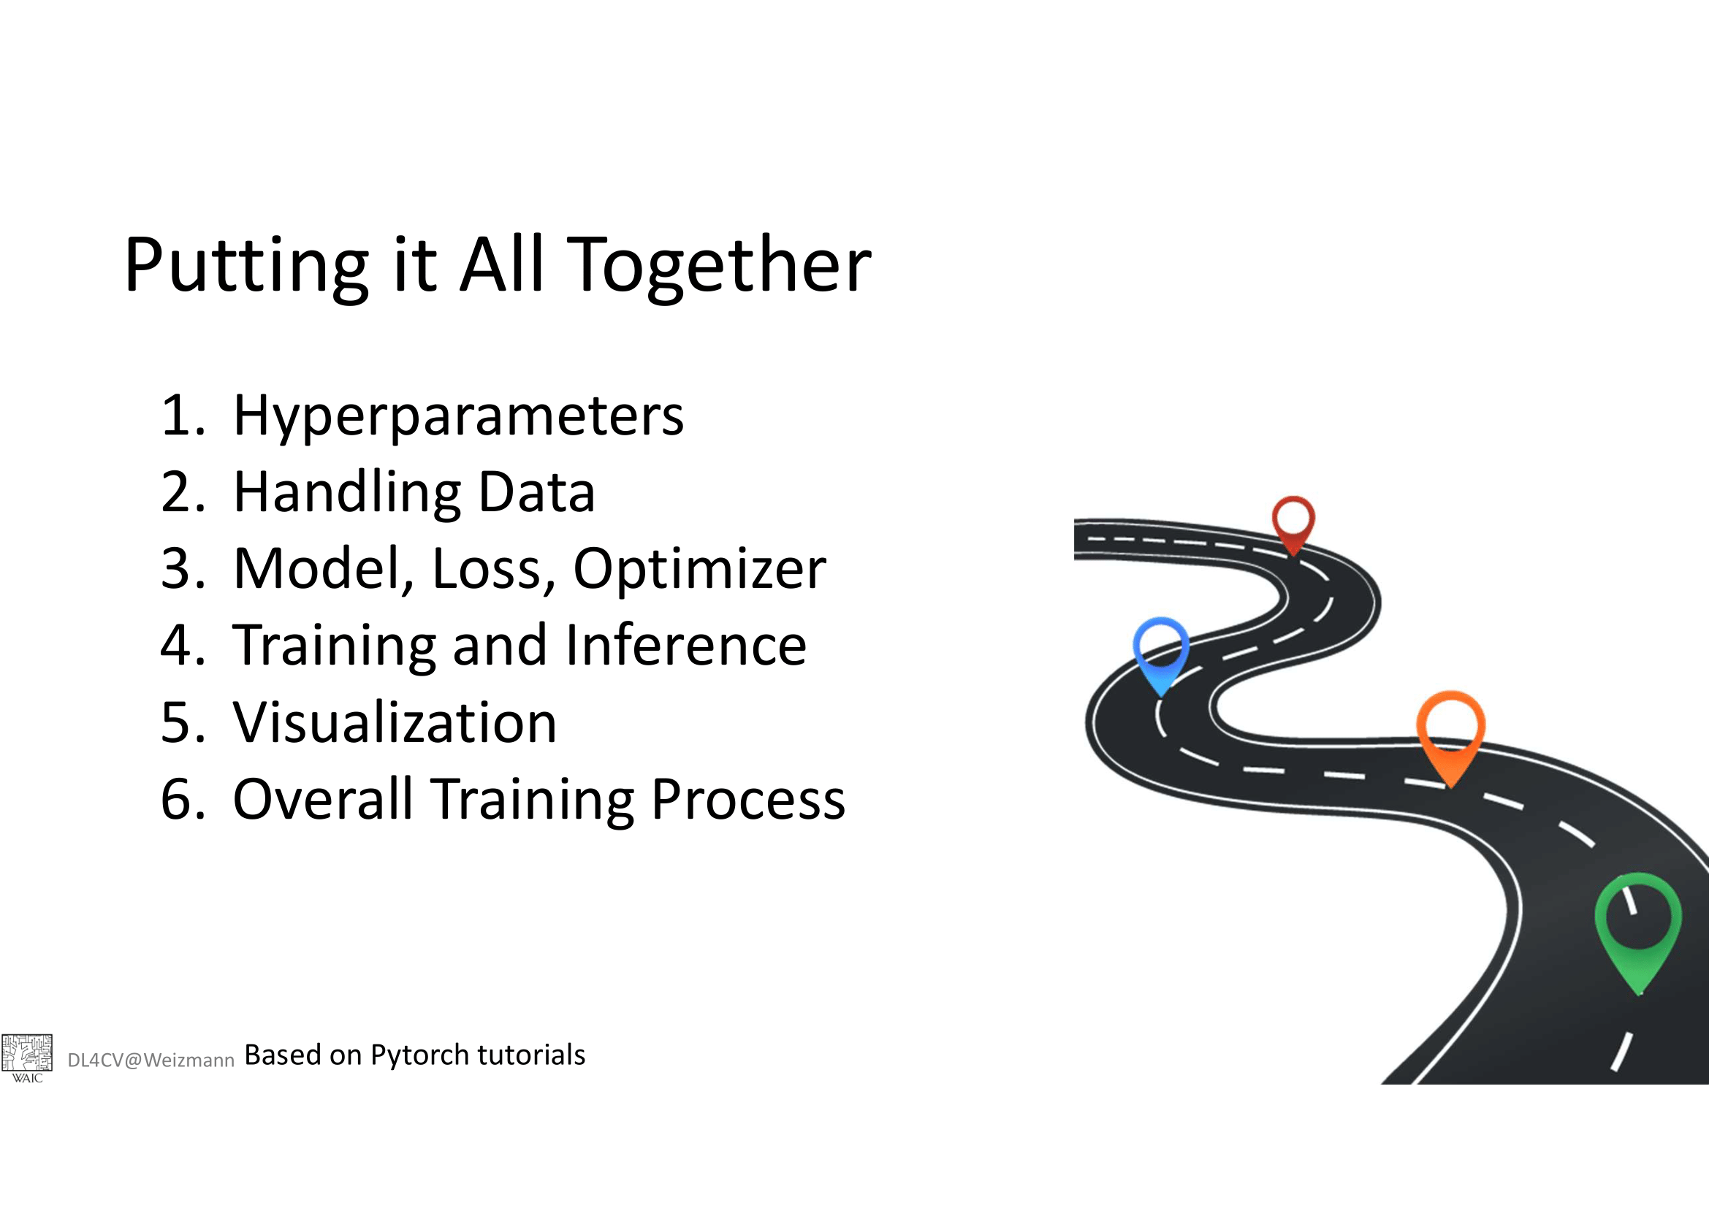

Slide 34
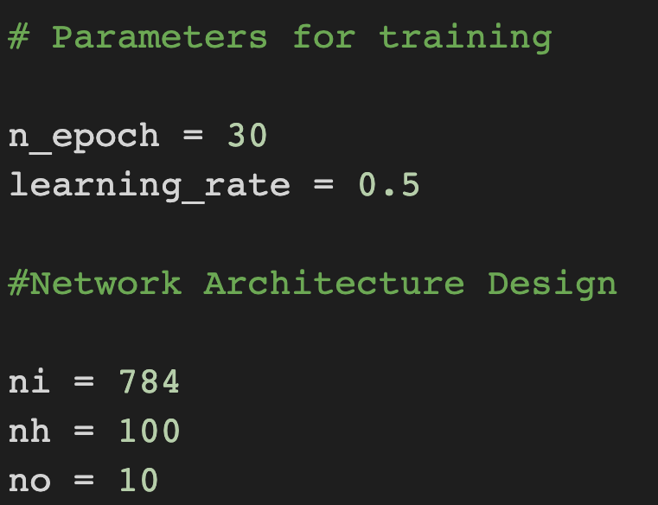
Hyperparameters
Learning rate
Momentum
Number of layers
Number of hidden units
Number of epochs

Slide 35
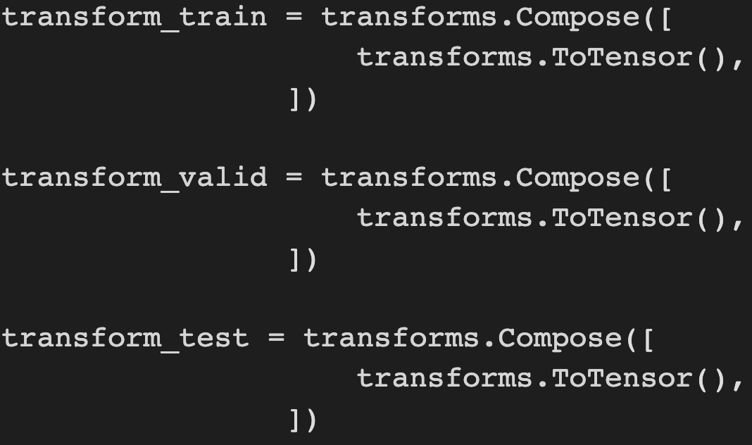
Data Handling

Slide 36
Model, Loss, Optimizer

Slide 37
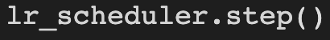
Learning Rate Schduler

Slide 38

Training and Inference

Slide 39
Visualizer

Slide 40
Tensorboard for monitoring training
Used for logging training data for directly plotting in Tensorboard UI
Helps us avoid writing the codes for plotting and comparing different training models and setups

Slide 41


Using Tensorboard

Slide 42

Tensorboard UI

Slide 43
Learning Rate Schduler
Large learning rates can result in divergence
Small learning rate can make convergence slow
Typically we want large learning rates at the beginning and progressively decreaser it
In PyTorch we can use learning rate schdulers to do that
In each epoch

Slide 44

Saving and Loading PyTorch models
Saving PyTorch Model:
Loading PyTorch Model

Slide 45
Vectorization
Vectorized code can make use of multiple cores and hence are faster
GPUs are sepcially suited for vectorized code as they have many cores
When running deep learning tools on GPU vectorization can bring immense speed ups.

Slide 46


Slide 47


Slide 48


Slide 49


Slide 50

Convolutional Neural Network (CNN)
Convolutional network
Local connectivity
Reuse parameters
$$z_{ij}=W∗x_{i,j}\text{=}{\sum_{a=0}^{m−1}{\sum_{b=0}^{m−1}{W_{ab}x_{(i+a)(j+b)}}}}_{}$$
Slides from Abin - Roozgard
Notes:
FC:
Complex: many parameters
Not consider locality of images
Not reuse weights

Slide 51

CNN – Filters
Multiple channels
Ex: RGB color

Slide 52

Convolutional Neural Networks

Slide 53

CNNs

Slide 54
Data Loaders

Slide 55


Slide 56

Dataset
Define
__len__()
__getitem__()
Returns:
dict
tuple
list

Slide 57

DataLoaders
Takes a dataset and a batch_size
And returns a dataloader object which can be used to iterate over the batches of the datset

Slide 58
Augmentation
Using Transforms to get additional samples of the training data

Slide 59


Transfer Learning: Fine-tuning

